Slide 1
Geography Knowledge Organisers
Year 11

Slide 2
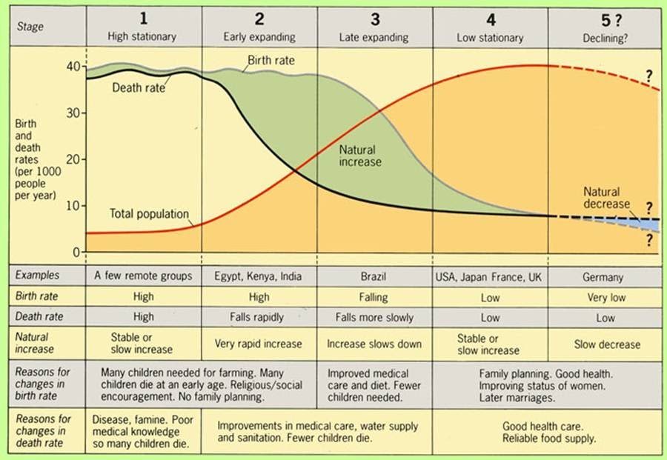
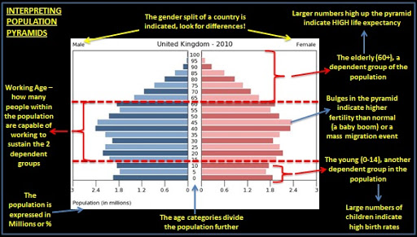
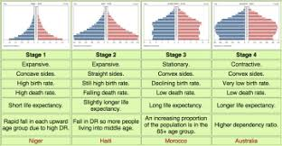
Development Gap Year 11 HT1
Indicator | Description | High or low
GDP/GNI | Economic indicator. A measure of a countries wealth | High in a developed country
Birth rate | Number of births per 1000 per year | Low in a developed country
Death rate | Number of deaths per 1000 per year | Low in a developed country
Adult literacy | % adults who can read and write | High in a developed country
Infant mortality | % babies that die before the age of one | Low in a developed country
A single measure of development can give a false picture as it gives an average for the whole country. Data could be out of date and the informal economy is not often included
The human development index (HDI)
is a better measure as it includes 3 development indicators:
Life expectancy, GDP and adult literacy
The demographic transition model is a guide as to how countries population can change over time. Their populations will go through a series of stages as their birth rates and death rates change. Developments in sanitation and medicine will begin to have an impact on these two indicators.

Slide 3


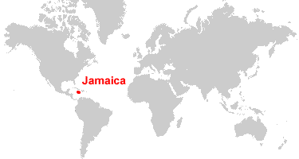
Development Gap Year 11 HT1
Disparities in wealth can affect health In rich countries there is money to pay for hospital and vaccines. In poorer countries there is less money for health care. In LIC’s death is usually from infections diseases and in childbirth. In HIC’s death is related to old age or lifestyle choices leading to cancers and heart problems.
Disparities in wealth can affect migration..
Migration = people move from place to place.
Internal migration = within a country
International migration = across country borders
Economic migration = moving to earn more money
Refugee = fleeing from a place of danger
Up to 2016 any one from the European Union was free to move to the UK. Most migrants work and pay tax. Migrants can put pressure on services like schools
Causes of uneven development
Physical: The nature of the landscape ( deserts/mountains/tropical rainforests) can make development challenging. Extreme natural events ( tropical storms/earthquakes) can lead to money spent on recovery not development. Some countries are landlocked making trade expensive and politically challenging.
Historical: Many European nations had African countries all colonies. They took their resources and when these countries got Independence it resulted in civil wars hampering development
Economic: Many pooper nations trade primary goods( raw materials) these have a low value and the price fluctuates world trade is dominated by the wealthy countries. Processing which adds value takes place in richer countries.
Middle East crisis of 2015. Civil war in Syria lead to the migration of millions of people into Europe to seek safety. An estimated 1.1 million migrants entered Germany in 2015
Reducing the development gap: Investment
Countries and TNC’s invest money and expertise in LIC’s China have invested in a railway in Nigeria and a power station in Zimbabwe. There are some benefits but many think it’s a type of exploitation benefitting China
Reducing the development gap: Industrial Development
Countries invest in manufacturing housing is built and hospitals roads and railways. Population becomes better educated and healthier and industry can expand. This is called the POSITIVE MULTIPLIER EFFECT
Reducing the development gap: Tourism
Countries with Tropical beaches etc. can attract tourists. Investment in the local area can benefit the local economy and people get jobs. However there can be damage to the natural environment and it is vulnerable to recession
Reducing the development gap: Intermediate technology.
Intermediate technology is sustainable and appropriate to the needs, knowledge and wealth of the local people. EG: Adis Nifra In Ethiopia where as small dam was created to help with irrigation
Closing the development gap: Fair Trade
Fair trade is an international movement that sets standards for trade to ensure that producers in LICs get a fair deal. Fair trade also helps to fund local community projects and all farming is done in environmentally friendly way
Reducing the development gap: Aid
Aid is when a government or non government organisation NGO gives help to another country in the form of money, emergency supplies, food or specialist skills. It can help by enabling countries to invest in roads, health care and education. Only Aid that is long term and freely given can really help to close the development gap.
What is Free trade?. Free trade is when countries can trade with each other without tariffs ( taxes). This has the potential to benefit the worlds poorest. However subsidies are a barrier to free trade. This is when rich countries give money to their farmers to help them produce goods cheaply. This can steal trade from Lic’s.
Economy
Tourism is 24% of GDP in Jamaica
Some money earned from tourism goes to the HIC travel companies
Infrastructure
Investment in roads and airports
Some parts of the island remain isolated
Quality of life. In the popular resorts locals benefit.
In the rural areas life remains very hard
The environment
Conservation has created jobs
Mass tourism creates a lot of waste
Reducing the development gap : Micro finance.
This involves small scale financial support. Itt helps people especially women to start up small businesses. The Garmeen bank is an example
Jamaica is a small Caribbean Island chosen tourism as a way to close the development gap. There are positives and negatives to this. It has
What is a trading group? Countries can join together to get higher prices for their goods. EG the EU

Slide 4
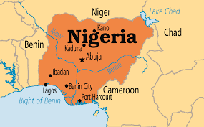
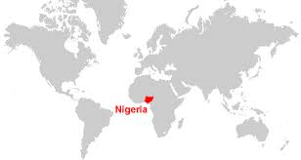
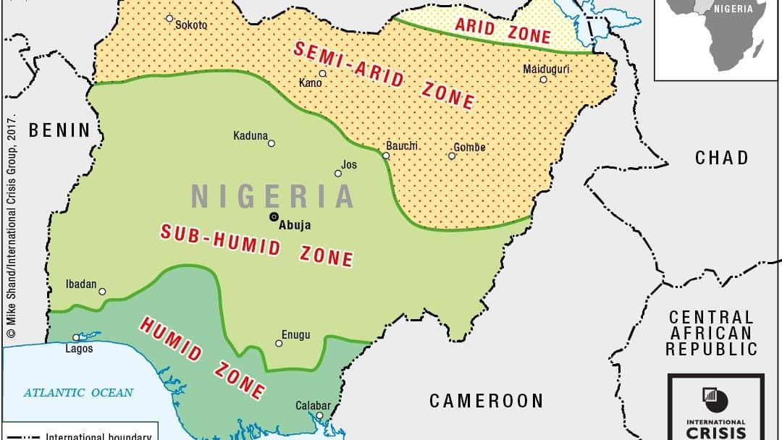
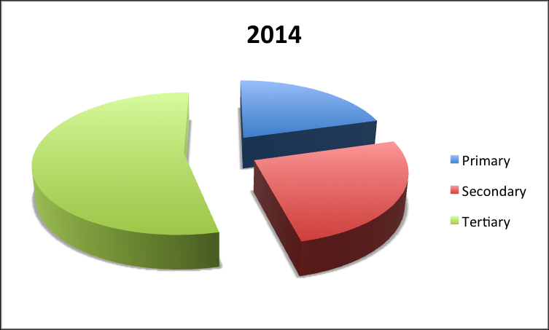
Exploring Nigeria: CASE STUDY Year 11 HT2
Political Context: During colonial times Nigeria was ruled by the UK. It got its independence in 1960. Up to 1990 there was Political instability. Since then the Government has been more stable. Today China invest heavily in Nigeria
Nigeria's Importance
2014 Nigeria was the 21st largest economy in the world.
It had a population of 195.9 million in 2018
Nigeria contribute the UN peace keeping force.
It has the largest population in Africa.
It has the fastest growing economy in Africa
Background: Nigeria is a multi ethnic country. There was a civil war between 1967 and 1970. Christians to the South Muslims to the North where there is a terrorist group called Boko Haram
Political Links:
OPEC and the United Nations. Also the African Union
Semi desert
Tropical grassland and Savannah
Nollywood is the second largest film industry in the world
Manufacturing in Nigeria. Today manufacturing accounts for 10% of Nigeria's economy. EG Volkswagen. Regular paid work gives people an income. Industry stimulates growth in other areas of the supply chain. People pay taxes to the Government. This is an example of the multiplier effect
Trade: Nigeria exports: crude and refined petroleum, natural gas, rubber, cocoa and cotton.
Imports: refined petroleum from the EU and the USA cars from Brazil and the USA telephones from China
Today oil accounts for 95% of Nigerias export earnings
High temperatures and high rainfall
The effect of development on the Environment:
Industrial Growth: Pollution from factories gets in to the water supply. Gases get into the atmosphere. Many forests have been cleared for Industrial development
Urban Growth: Waste from homes is a major issue. Traffic congestion pollutes the air. More deforestation when the new capital ABUJA was built.
Mining and oil extraction: Tin mining leads to soil erosion. Oil spills can harm the coast and cause fires. Very bad spill BODO 2008-9
Commercial farming: Water pollution due to the use of chemicals, Soils erosion due to forest clearnce leads also to the loss of species
TNC’s in Nigeria : Two main Trans National companies in Nigeria are: Unilvever and Shell oil
Advantages of TNC’s
Employment and learning new skills
Investment in local infrastructure
Disadvantages of TNC’s
Poorly paid
Poor working conditions
Profit goes abroad
Problems with AID
Corruption is a major problem in the loss of AID donations
Donors may have political influence on where the Aid is sent
Nigeria could become dependant on the AID
Unilever. Anglo-Dutch TNC. Employs 1500 people. Helped to promote health care and education
Quality of life There have been many benefits to development: Higher disposable incomes. Improvements to infrastructure. Better access to safe water. Better quality health care. HOWEVER:
Many people are still very poor. The gap between the rich and poor is wider. Over dependant on oil which could be a problem in the future.
Nigeria's HDI has increased from 0.46 in 2005 to 0.50 in 2013
Aid in Nigeria Aid from the USA has helped to prevent the spread of AIDS. The world bank approved AID for loans for business
Shell One of the worlds largest oil companies.
Major contributions in taxes
Employs 65000people
Many oils pills have caused environmental damage
60% of Nigerians still live in Poverty and there remain real threats to the environment

Slide 5
Changing economy of the UK Year 11 HT3
Economic and Industrial Change in the UK
Key causes of change: De-industrialisation is the decline of traditional industries such as manufacturing. This has happened because: machines and technology have replaced many people. Other countries e.g. china can produce cheap goods because labour is less expensive. Globalisation — is the growth and spread of ideas around the world. Many people now work on global brands in the quaternary sector e.g. in IT. Increased world trade and cheaper imported products have contributed to the decline in UK manufacturing. Government policies — government decisions on investment in new infrastructure and technology and support for businesses (e.g. tax breaks) affect how well the economy grows. Membership in government groups, e.g. World Trade Organisation, make it easier for companies in the UK to operate across the world.
Moving towards a post-industrial economy:
A post-industrial economy is where manufacturing industry declines to be replaced by growth in the service sector and quaternary sector. This happened in the UK from the 1970s. By 2015, 78 per cent of UK employment was in the tertiary sector and 10 per cent in the quaternary sector. Only 10 per cent of employment was in manufacturing compared to 55 per cent in 1900. Development of information technology the use of IT is a key factor in the UK’s move to a post-industrial economy. Internet access allows people to work from home. Over 1.3 million work in the IT sector. And the UK is one of the world’s leading digital economies. Service industries and finance the UK service sector has grown rapidly since 1970s, today is contributes over 79% of the UK’s GDP. Finance is an important part of the service sector the UK is the world’s leading centre of financial services Some, like HSBC, have their global headquarters in the UK. The financial services sector accounts for about 10% of the UK’s GDP. Research and development (R&D) is increasing in the UK, making use of the UK’s highly skilled university graduates – research employs over 60,000 people. In 2013, nearly £30 billion was spent on R&D in the UK and it is estimated to contribute £3 billion to the UK economy and it one of the UK’s economy’ main growth areas in the future.
Environmental impacts of Industry on the physical environment
Large-scale extraction industries such as mining and quarrying can have an impact on the environment. Quarries have been cut out of the countryside and huge waste tips piled up on the edges of mining settlements. They can destroy natural habitats, pollute water courses and scare the landscape. | Modern manufacturing industries have an effect on both the landscape and the environment. Manufacturing plants can look very dull and uninteresting and can have a negative visual effect on the landscape. Industrial processes can cause air and water pollution, as well as degrading the soil. The transport of raw materials and manufacturing products is usually by road, which increases levels of air pollution and damage to the environment when roads are widened or new ones built
UK Science and Business Parks
A science park is a group of scientific and technical knowledge-based businesses located on a single site. Most are associated with universities, enabling them to use research facilities and employ skilled graduates. Science parks may also include support services such as financial services and marketing. Science parks often have: Good transport links – close to motorways/ railway / airports. Excellent links with universities. Attractive location with green areas. A business park is an area of land occupied by a cluster of businesses. Business parks are usually located on the edges of towns because: land tends to be cheaper than in town centres and with more land, it may be possible to extend businesses. Access is also better with less congestion. Businesses can benefit by working together.

Slide 6
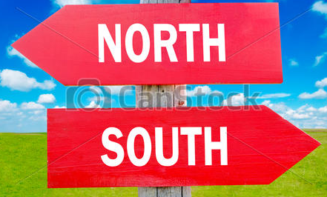
Changing economy of the UK Year 11 HT3
How can industrial development be more sustainable?
Today there is a much greater concern about the need for industries to be environmentally sustainable. This can be achieved in a number of ways. • Technology can be used to reduce harmful emissions from power stations and heavy industry. • Desulphurisation can remove harmful gases such as sulphur dioxide and nitrogen oxide from power station chimneys. • Stricter environmental targets put in place for industry on water quality, air pollution and landscape damage. • Heavy fines imposed when an industrial pollution incident occurs. Quarrying can be made more sustainable with: • Strict controls on blasting and removal of dust from roads and landscaping • Recycling is encouraged • Companies are expected to restore of improve a quarry after it has been used.
Named Example: Torr Quarry, Somerset
Torr Quarry is an example of how modern industry can be more environmentally sustainable. Torr Quarry is a limestone quarry in the Mendip Hills. It employs over 100 people and contributes more than £15 million towards the local economy each year. • The quarry is being restored to create wildlife lakes • 200 acres of the site have already been landscaped • Regular monitoring of noise, vibration, dust and water quality. • Rail transport of quarried rock minimises the impact om local roads.
North-South Divide
What is the north-south divide? It refers to a real of imagined cultural and economic differences between the south of England and the rest of the UK. In general the south enjoys high incomes and longer life expectancy., But the south also has higher house process and more traffic congestion.
Why is there a north-south divide?
• During the Industrial Revolution, the UK’s growth was centred on coalfields, heavy industries and engineering in northern England, Wales and Scotland. • Since 1970s, many industries have declined, reducing prosperity in those areas. • London and the South East developed rapidly due to a fast-growing service sector.
How can regional strategies address the north-south divide?
Local Enterprise Partnerships (LEPS) LEPS are voluntary partnerships between local authorities and businesses. Their aim is to identify business needs and encourage companies to invest in order to boost the local economy and create jobs. Lancashire LEP will: promote new businesses and create 50,000 new jobs by 2023. Improve transport with £20 million investment. Extend superfast broadband across 97% of the region. Create 6,000 high-skilled jobs in Enterprise Zones at Samlesbury and Warton. Enterprise zones will encourage new businesses and jobs. The government supports businesses in Enterprise Zones by: providing business rate discount, ensuring the provision of superfast broadband, creating simpler planning regulations. Northern Powerhouse linking northern cities – Liverpool, Leeds, Manchester, Sheffield, Hull and Newcastle to match, rival and compete with the economic power of London. It includes improving transport links e.g. High Speed 2 railway, Mersey Gateway bridge and the Trans-Pennine train route. As well as investing in science and innovation and to devolve the powers of government away from London’s parliament to Northern cities. Cities would get more power and spending decision so that they can invest money directly where it is needed locally and also have elected mayors.

Slide 7


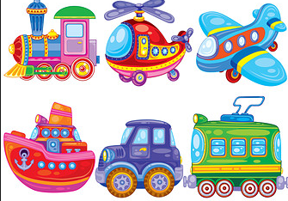

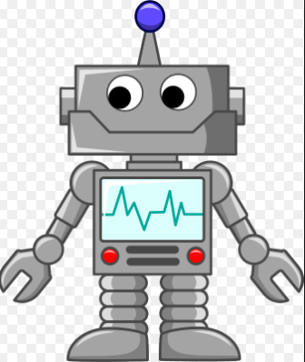
Changing economy of the UK Year 11 HT3
UK Global Links
Political | Commonwealth These are 53 states across the world that were part of our colonial history Many expats live there (Brits who live abroad) The Queen is head of state in 16 of these countries promotes democracy, good governance, human rights and economic development as the UK trades with its previous colonies EU We joined the EU in 1979 and opted to leave in 2016. About 50% of exports and imports are to the EU It’s now a bit confusing as we go through the Brexit process about what will happen to EU laws that we have.
Trade | 49.6% of the UK’s exports went to EU countries, and 50.4% went to non-EU countries such as the USA and China, The USA takes the most. A lot of trade is now finance and communications following deindustrialisation.
Transport | More than 750,000 international flights depart from the UK annually to 400 airports in 114 countries Heathrow is the 4th busiest airport in the world Eurotunnel (Channel Tunnel) links our island to Europe as well as sea ferries.
Culture | English Language has helped us set up strong links Students abroad can sit British exams UK TV productions have a global audience e.g. Doctor Who We are a culture of immigration leading to a unique and multicultural society
Technology | 90% of population has internet – very connected! We spend more online shopping than anywhere in Europe 18 million businesses run from home
UK Transport Links
Ports | Air | Roads
32 million passengers travel though UK ports. Ports employ 120,000 people. Liverpool2 project will double the ports capacity to over 1.5 million containers a year % create thousands of jobs and boost the regional economy. | Airports create vital global links, provide 1000s of jobs and boost economic growth. Heathrow might have a 3rd runway built to expand its capacity, however people living nearby are concerned about noise and air pollution. | Road Investment Strategy includes: 100 new road schemes, 1300 new miles added to motorways. Extra lanes added to motorways to make them smart motorways.
Changing rural landscapes in the UK
Growth; South Cambridgeshire The population is increasing due to migration – migrants from Cambridge, other parts of the UK and eastern Europe. Social Effects: 80% car ownership leads to increased traffic on narrow roads. Housing developments on the edges of villages can reduce community spirit. Economic effects: reducing in agricultural employment, lack of affordable housing, high petrol prices, pressure on services due to growing population. | Decline, Outer Hebrides The population has declined by 50% since 1901, people move away due to limited employment opportunities. Social Effects: school closures due to too few children. Ageing population has fewer young people to support them. Economic effects: services are closing, small farms can only provide work for 2 days a week, there has been an increase in tourism, but the infrastructure can support the scale of tourism needed.

Slide 8
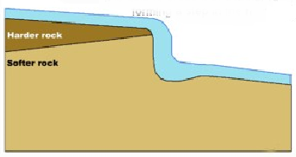
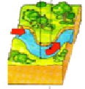

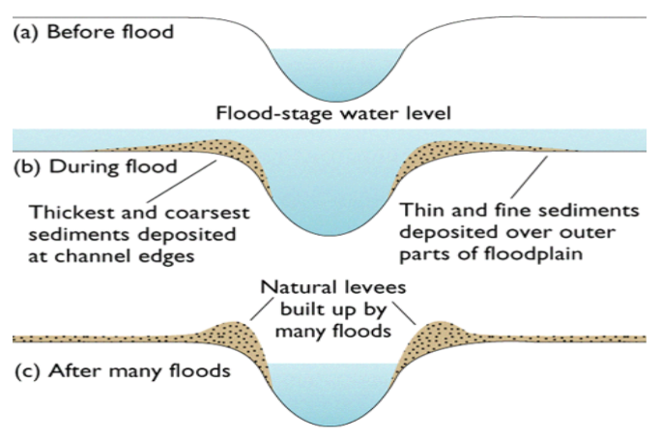
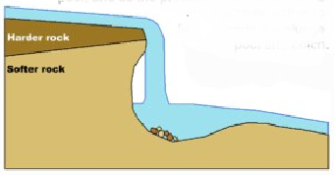
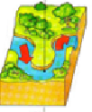
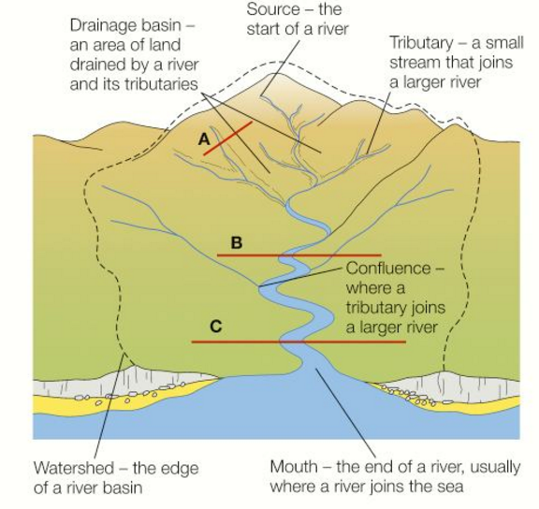
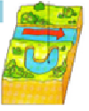
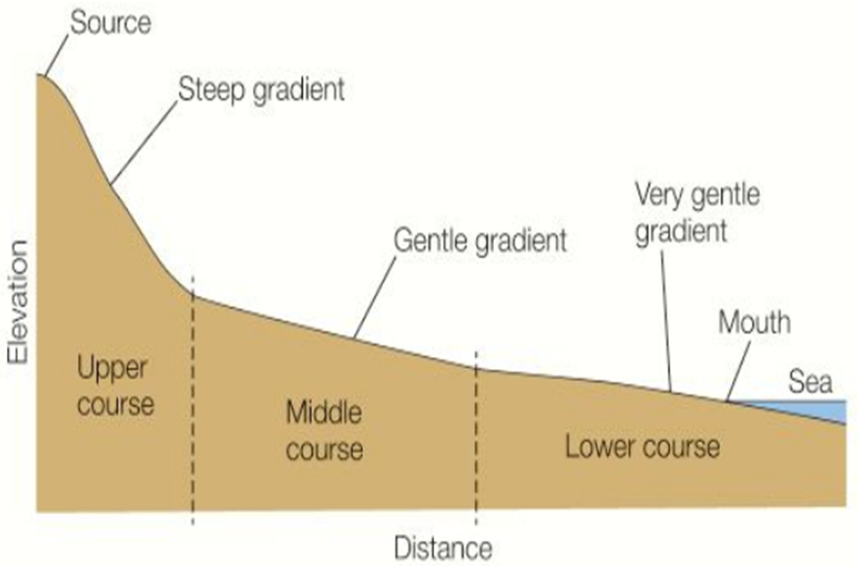
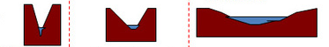

Rivers of the UK Year 11 HT4
Upper Course of a River
Near the source, the river flows over steep gradient from the hill/mountains. This gives the river a lot of energy, so it will erode the riverbed vertically to form narrow valleys.
Middle Course of a River
Here the gradient get gentler, so the water has less energy and moves more slowly. The river will begin to erode laterally making the river wider.
Lower Course of a River
Near the river’s mouth, the river widens further and becomes flatter. Material transported is deposited.
Formation of a Waterfall
 | 1) River flows over alternative types of rocks.
 | 2) River erodes soft rock faster creating a step.
 | 3) Further hydraulic action and abrasion form a plunge pool beneath.
 | 4) Hard rock above is undercut leaving cap rock which collapses providing more material for erosion.
 | 5) Waterfall retreats leaving steep sided gorge.
Formation of Ox-bow Lakes
Step 1
 | Erosion of outer bank forms river cliff. Deposition inner bank forms slip off slope.
Step 2
 | Further hydraulic action and abrasion of outer banks, neck gets smaller.
Step 3
 | Erosion breaks through neck, so river takes the fastest route, redirecting flow
Step 4
 | Evaporation and deposition cuts off main channel leaving an oxbow lake.
Formation of Floodplains and levees
When a river floods, fine silt/alluvium is deposited on the valley floor. Closer to the river’s banks, the heavier materials build up to form natural levees.
Nutrient rich soil makes it ideal for farming. Flat land for building houses.
Key Words:
Source
Mouth
Watershed
Tributary
Confluence
Vertical and Lateral Erosion
Deposition
Sediment
Long Profile of a River
Cross Profile of a River
Upper
Course
Middle Course
Lower
Course

Slide 9
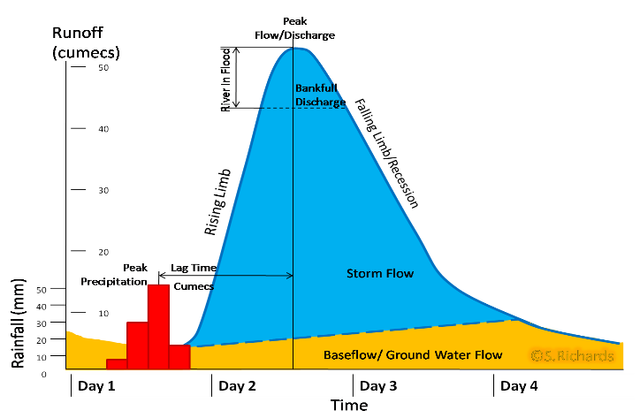
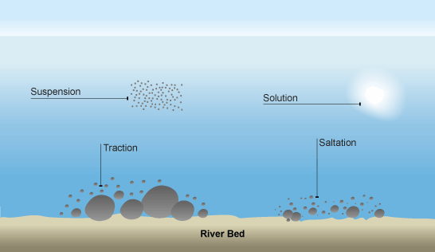
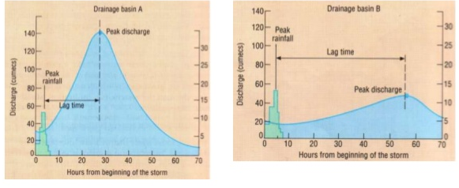
Rivers of the UK Year 11 HT4
Types of Erosion
The break down and transport of rocks – smooth, round and sorted.
Attrition | Rocks that bash together to become smooth/smaller.
Solution | A chemical reaction that dissolves rocks.
Abrasion | Rocks hurled at the base of a cliff to break pieces apart.
Hydraulic Action | Water enters cracks in the cliff, air compresses, causing the crack to expand.
Types of Transportation
A natural process by which eroded material is carried/transported.
Solution | Minerals dissolve in water and are carried along.
Suspension | Sediment is carried along in the flow of the water.
Saltation | Pebbles that bounce along the sea/river bed.
Traction | Boulders that roll along a river/sea bed by the force of the flowing water.
Hydrographs and River Discharge
River discharge is the volume of water that flows in a river. Hydrographs who discharge at a certain point in a river changes over time in relation to rainfall
1. Peak discharge is the discharge in a period of time.
2. Lag time is the delay between peak rainfall and peak discharge.
3. Rising limb is the increase in river discharge.
4. Falling limb is the decrease in river discharge to normal level.
What is Deposition?
When the sea or river loses energy, it drops the sand, rock particles and pebbles it has been carrying. This is called deposition.
Factors affecting hydrographs
Flashy Hydrograph Steep Slopes Small drainage basin Impermeable surface Low levels of vegetation High levels of precipitation | Low Hydrograph Gentle slopes Large drainage basin Permeable surface High levels of vegetation Low levels of precipitation
Physical and Human Causes of Flooding
Physical: Prolong & heavy rainfall Long periods of rain causes soil to become saturated leading runoff. | Human: Deforestation when trees are removed, this will increase surface runoff as the water will not be intercepted.
Physical: Relief Steep-sided valleys channels water to flow quickly into rivers causing greater discharge. | Human: Land Use Tarmac and concrete are impermeable. This prevents infiltration & causes surface runoff.
Physical: Geology Impermeable rocks causes surface runoff to increase river discharge. | Human: Agriculture Farming of crops can often leave the soil exposed and leads to rapid surface run off.

Slide 10
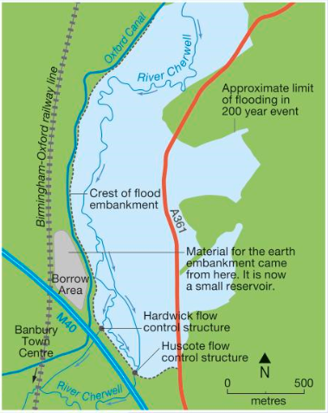
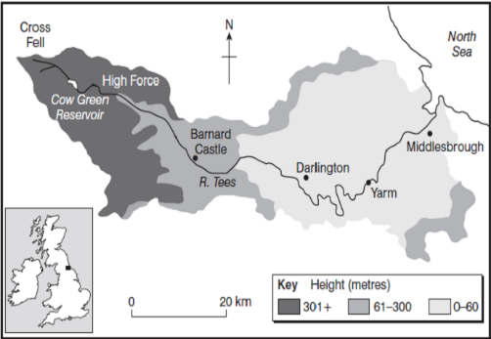
Rivers of the UK Year 11 HT4
Named Example: The River Tees
Location and Background Located in the North of England and flows 137km from the Pennines to the North Sea at Red Car.
Geomorphic Processes Upper – Features include V-Shaped valley, rapids and waterfalls. Highforce Waterfall drops 21m and is made from harder Whinstone and softer limestone rocks. Gradually a gorge has been formed. Middle – Features include meanders and ox-bow lakes. The meander near Yarm encloses the town. Lower – Greater lateral erosion creates features such as floodplains & levees. Mudflats at the river’s estuary.
Management -Towns such as Yarm and Middleborough are economically and socially important due to houses and jobs that are located there. -Dams and reservoirs in the upper course, controls river’s flow during high & low rainfall. - Better flood warning systems, more flood zoning and river dredging reduces flooding.
River Management Schemes
Soft Engineering | Hard Engineering
Floodplain zoning-restrict land use to certain locations River restoration – return river to original course e.g. River Quaggy Demountable Flood Barriers put in place when warning raised. E.g. Bewdley Managed Flooding – naturally let areas flood, protect settlements. E.g. Banbury | Dams and reservoirs – regulate river flow eg Rutland Straightening Channel – increases velocity to remove flood water. Artificial Levees – heightens river so flood water is contained. Flood relief channel – man made channel to by-pass an urban area e.g. Jubilee River
Named Example: Managing Floods at Banbury
Why required Banbury is located in the Cotswold Hills and much of the town is on a floodplain of the River Cherwell, a tributary of the Thames. Population = 45,000 . Banbury has a history of devastating floods. Flooding in 1998 – closure of railway station, roads closed and caused £12.5 million of damage.
Management Strategy - 2012 2.9km earth embankment along M40 – flood storage area Flow control structures in the embankment – controls the rate of flow downstream to Banbury. Raised A361 and improvements in road drainage. New earth embankments and floodwalls. New pumping station New Biodiversity Action Plan (BAP)
Social, Economic and Environmental Issues Social - Raised A361 will be open - Improved quality of life for locals – footpaths/ green areas - Reduced levels of anxiety Economic - Cost £18.5 million Donors – Environment Agency Cherwell District Council - Protects 441 houses 73 businesses benefits +£100m. Environmental - 100000 tonnes earth needed to build embankment. New BAP – ponds, hedgerows. Part of floodplain – allowed to flood.

