Slide 1
Geography Knowledge organisers
Year 9

Slide 2
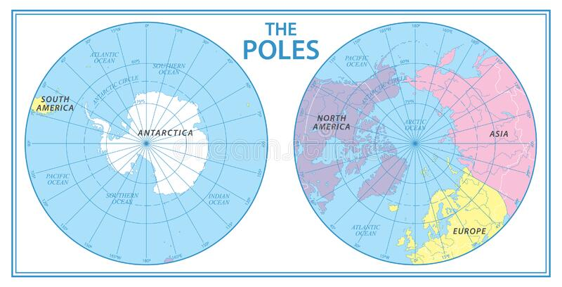
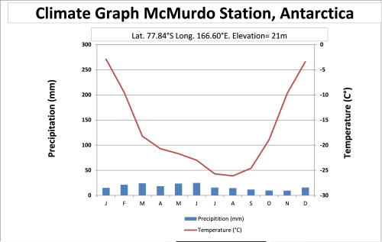
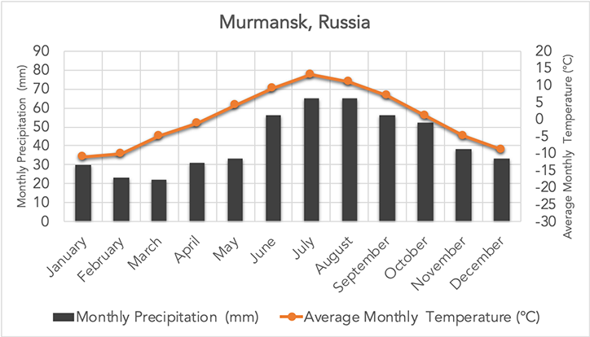
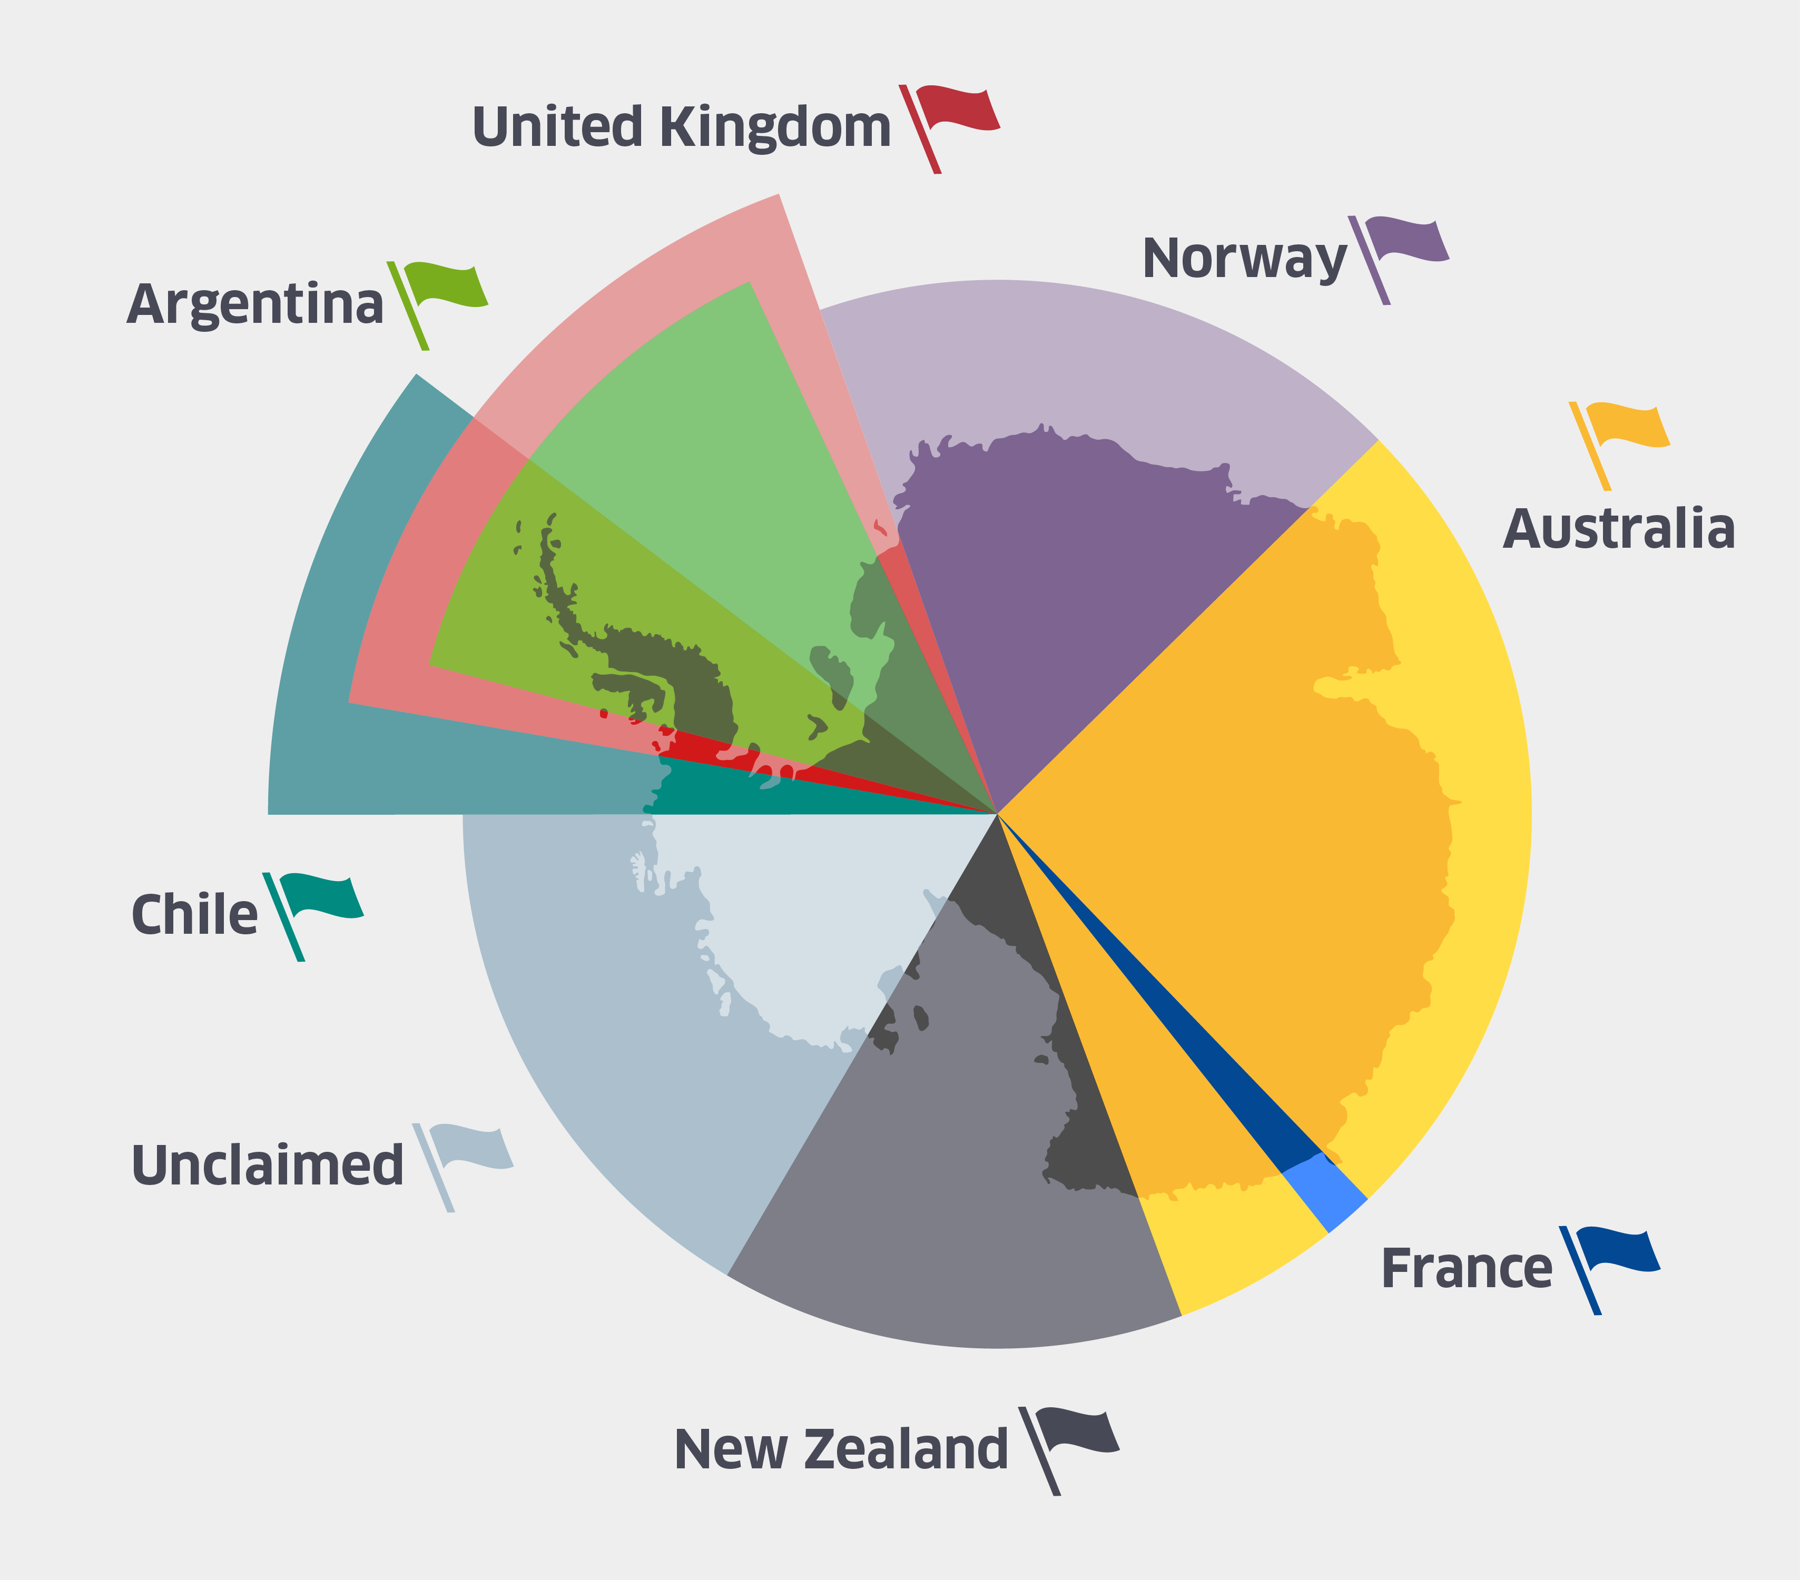
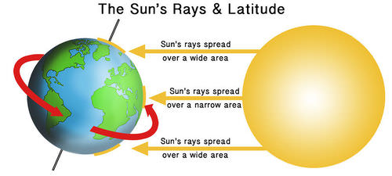


Polar Regions Year 9 HT1
Where are the Polar regions
Climate in the Polar regions
Antarctic Treaty
Countries that sign the treaty agree:
To make Antarctica a natural reserve that is devoted to peace and science
To allow scientists freedom to work
To share scientific knowledge
To set aside any territorial claims
To ban nuclear explosions and the disposal of radioactive waste
To make sure all visits to Antarctica comply with the treaty
To ban all commercial mining until at least 2048.
To ensure all waste is disposed of without damaging the environment
To protect all Antarctic animals and plants.
Challenges of Tourism in Antarctica
Most people only stay on land for a few hours | Invasive species can be brought onto land as seeds stuck to the soles of shoes | Cruise ships an leak oil and damage the marine environment
Tourists can become champions of Antarctica | Tourists cant visit all year due to the harsh winter climate so this limits numbers | Fragile plants can get trampled
Nesting birds can be disturbed | Tourists and visitors get to appreciate the beauty of the last great wilderness | Erosion of paths where most tourists walk
Waste created by visitors has to be dealt with | Antarctica has no native residents so tourists can speak up for Antarctica | Small boats can disturb the resting sites of seals off shore
KEY Vocabulary Indigenous, Arctic, Antarctica, biome, adaptation, climate change, permafrost, endangered, culture, nomadic, trade, erosion, migration, fossil fuels, icecap, treaty, conflict.

Slide 3
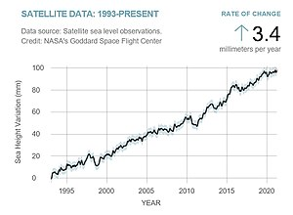
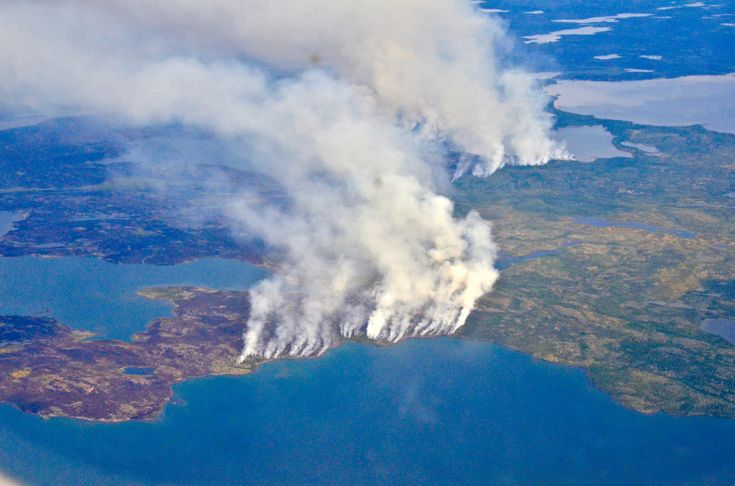
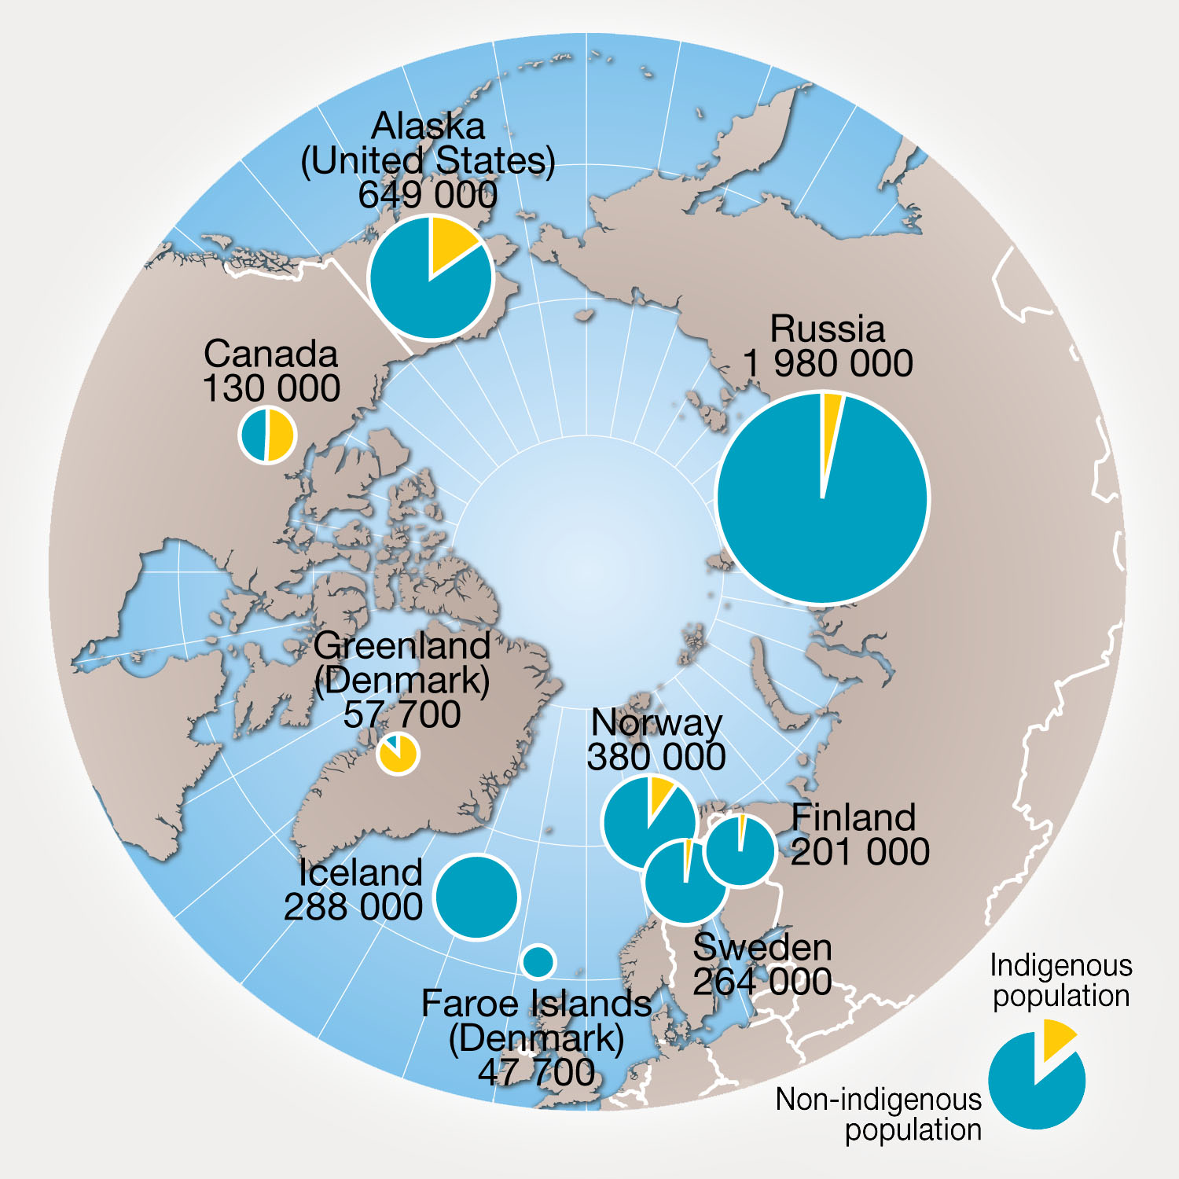
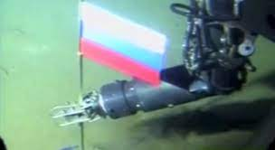
Polar Regions Year 9 HT1
What are the issues with ICE MELTING: ANTARCTICA
Temperatures in Antarctica are rising
Ice sheets have broken off
Glaciers in some places are melting
Global sea levels are rising
Not all of Antarctica is meting
The majority of Antarctica remains frozen
What are the issues in the Arctic
Apart from the Greenland icecap the Arctic is frozen ocean.
Ocean temperatures rarely fall below -2°C which makes it on the whole warmer than Antarctica
There are 8 countries which have land and a share of Arctic: Norway, Sweden, Finland, Russia, USA (Alaska), Denmark (Greenland), Canada and Iceland.
Across these 8 countries indigenous people make up about 10% of the 4 million people that live there.
Out of these 4 million inhabitants in the Arctic, 2 million are Russian
The people of the Arctic
Over 4 million people call the Arctic home with well over 30 different languages spoken. The original inhabitants of the Arctic region are known as indigenous people and there are many different cultures in many of the Arctic nations.
Rising global temperatures are having a catastrophic effect in the Arctic. Recent years have seen such high temperatures that there have been a number of serous fires
Russia's Plans for the Arctic
Russia has the longest coastline of all the Arctic nations. As the ice melts it opens up tremendous possibilities for Russia.
Currently their major coastline is frozen for 6 months of the year so as the ice melts this reveals their coastline and potential new trade routes, shipping ports and oil exploration are possible.
Russia have already laid claim to the seabed under the ice at the North pole by planting a flag on the sea bed
Issue for the indigenous people of the Arctic:
Ice is thinning making hunting hazardous
Migration of caribou is changing
Animals have less meat
Competition with oil companies
Questions to consider:
Can the traditional life of the indigenous people survive?
Will future generations respect the Antarctic treaty
Will Russia push ahead with plans to develop their Arctic coast?
Ambitious Vocabulary:
Extensive, Flourish, exploit, undermine, consensus
Careers: Antarctica scientist/researcher £50-80,000 per year
Engineer working in the Arctic £65,000 per year

Slide 4
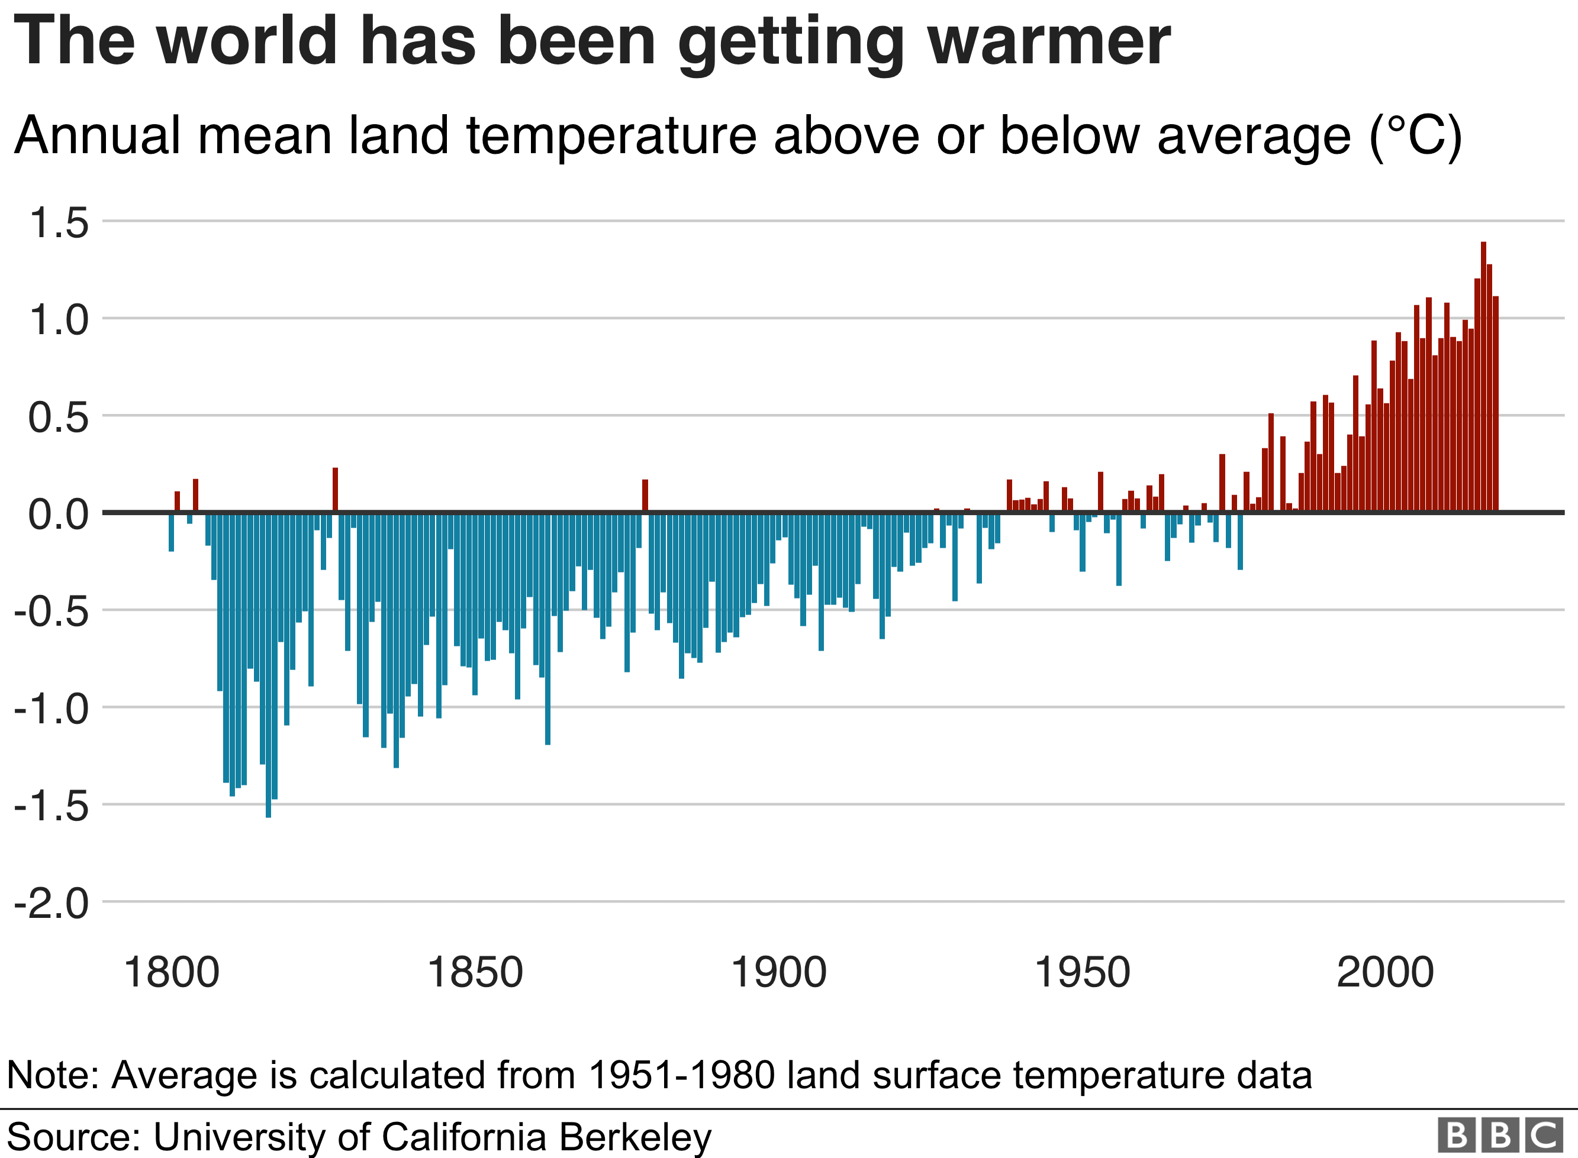
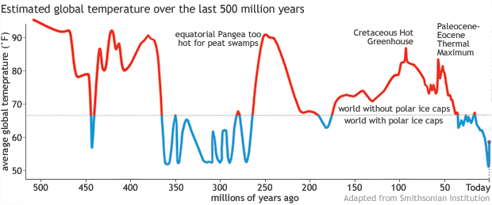
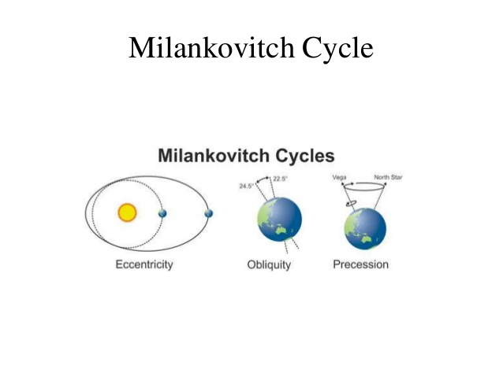
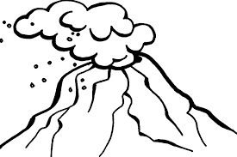
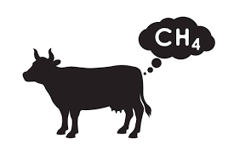
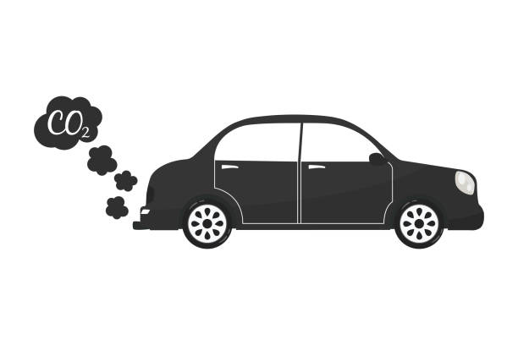
Climate change Year 9 HT2
KEY VOCABULARY
Adaptation
Alternative energy
Atmosphere
Axial tilt
Carbon capture and storage (CCS)
Carbon dioxide
Carbon sinks
Climate change
Eccentricity
Enhanced greenhouse effect
Fossil fuel
Global warming
Greenhouse effect
Greenhouse gas
Ice cores
Milankovitch cycle
Mitigation
Nitrous oxide
Precession
Quaternary period
Renewable energy
Solar flare
Solar radiation
Sunspots
Volcanic eruption
Evidence for past changes in climate:
Ice cores
Ocean sediments
Rising sea levels
Shrinking glaciers
Shrinking sea ice
Human causes of climate change
Carbon dioxide | Burning fossil fuels | Car exhausts | Deforestation and burning trees
Nitrous oxide | Sewage treatment | Car exhausts | Electricity production
Methane | Farm livestock | Rice farming | Rotting rubbish in landfill
Natural causes of climate change are:
The Milankovitch cycles
Solar activity: sunspots, solar flares average 11 year cycle
Volcanic activity: Ash blocks sun, Sulphur dioxide mixes with water =sulphuric acid = reflects sun= volcanic winter

Slide 5
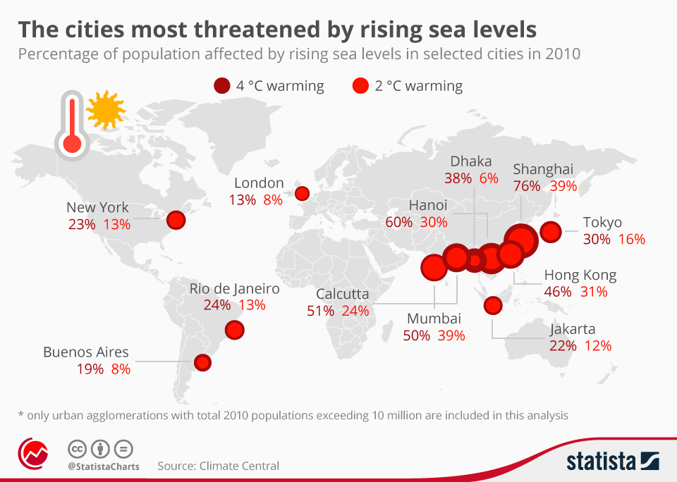
Climate change: Management (adaptation and mitigation)
Year 9 HT2
Mitigating against climate change means reducing the impacts of climate change
You need to be able to:
Describe the methods
Explain how they will work
Evaluate their effectiveness
Adapting to climate change means accepting that things will change and finding ways to alter what we do
Many changes will have to happen in Agriculture:
Introduce drought resistant plants
Use new irrigation systems
Introduce water harvesting
Plant trees for shade
Change when you plant and sow seeds
Alternative energy sources:
Solar, wind,
hydroelectric.
Nuclear
Burring fossil fuels produces greenhouse gases so reducing their use is important in reducing greenhouse gas emissions
What are the global impacts of climate change?
Lower crop yields
Increased risks of drought and floods
Increased heat related diseases
Stronger tropical storms
Increased desertification
Wildlife extinction and changing migration
Rising sea levels coastal flooding
Managing water supply will become increasingly important:
Harvesting water off glaciers in the summer and storing it so it freezes in winter ready to provide regular water supply in the summer as the ice melts
Carbon capture:
Filtering carbon out of the air, diluting it in water and injecting it into the ground so it is locked away
Can you identify social, economic and environmental impacts?
Managing rising sea levels:
In the Maldives they have
Built sea walls
Houses on stilts
Build artificial islands
Restore coastal mangrove
Planting trees: Trees absorb CO2. The more we plant the more CO2 is locked away
International agreements:
2005 in Kyoto
2009 in Copenhagen
2015 in Paris
2021 in Glasgow

Slide 6
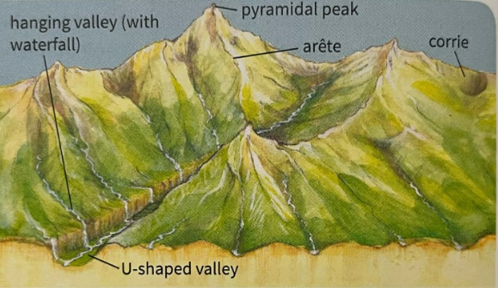
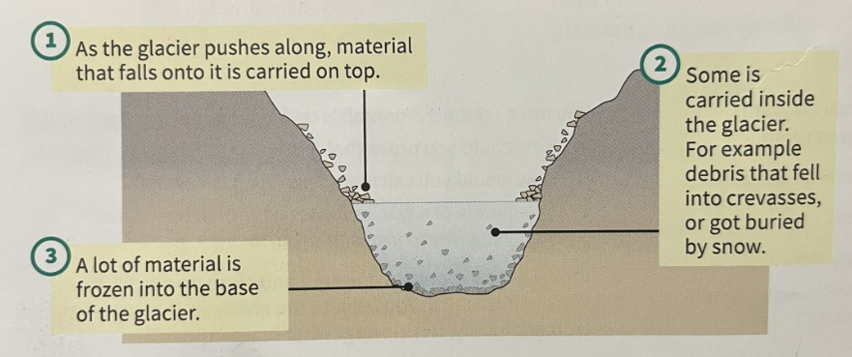
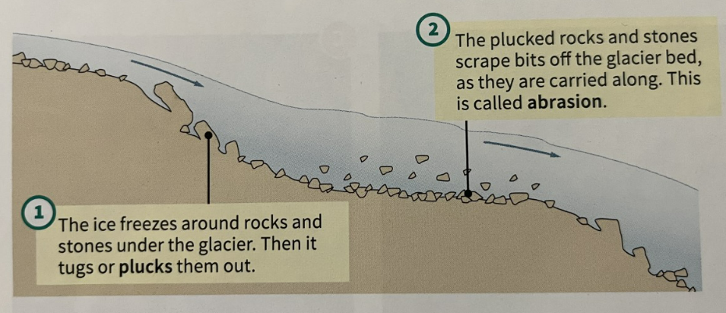
Glaciation Year 9 HT3
Tier 3 - Vocabulary
Ice age, tundra, glacier, glaciated, ice shelf, iceberg, crevasses, erosion, transportation, deposition, plucking, abrasion, freeze-thaw, corries, arêtes, pyramidal peaks, hanging valley, u-shaped valley, ribbon lake, till, terminal moraine, lateral moraine, ground moraine, erratics, drumlins
Tier 2 - Vocabulary
Compacted
Flow
Spectacular
Bulldoze
Route
What and where are glaciers?
During the last ice age ice covered about a third of Earth’s land.
Glaciers are large masses of ice that flow across the land. Giant glaciers are called ice sheets.
Glaciers are found on every continent.
Antarctica and Greenland contain 99% of Earth’s ice.
Mountain or alpine glaciers are much smaller than ice sheets.
Glaciers depend on snow. They form when snow falls layer upon layer and become compacted into ice. It takes a layer of snow 10m thick to make 1m of ice. As the ice gets heavier it starts to flow.
Ice can flow inside a glacier because the ice crystals slide over each other, under pressure. The ice at the bottom of a glacier can melt due to the weight of the glacier causing the glacier to slide along on the melted water.
Mountain glaciers flow down the sides of mountains and eventually meet a place where they melt.
Ice sheets flow out to the thinnest parts. In Antarctica they flow into the oceans and form ice shelves.
How do glaciers shape the land?
As glaciers flow they scrape and shape the landscape like giant bulldozers.
Erosion Processes
Transportation Processes
Deposition Processes
Till is the load in a glacier which has fallen to the floor. Water melting from ice is called melt water. It runs off to feed rivers and lakes.
Landforms shaped by erosion
Corries start as sheltered hollows that are deepened by abrasion and plucking. They can often have lakes in them called tarns.
Arêtes are a sharp ridge formed by two back-to-back corries.
Pyramidal Peaks are formed by three or four corries forming around a mountain top.
U-shaped valleys begin as v-shaped valleys that are bulldozed by a glacier and widened and deepened. They often contain misfit rivers.

Slide 7
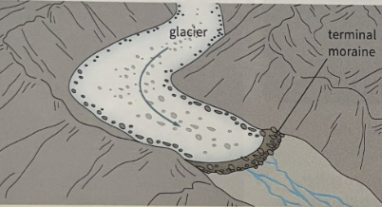
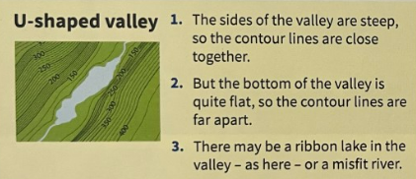
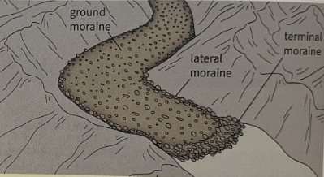
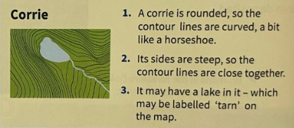
Glaciation Year 9 HT3
Careers linked to glaciated landscapes:
Glaciologist – A scientist who conducts tests to understand the movement and processes of glaciers and snow.
Ski-instructor – Someone who teaches skiing to large groups of people of similar ability or to individuals.
Mountain Rescue - teams of highly trained individuals who come to the aid of the injured, unwell, lost or missing in our mountain regions
Living in a glaciated landscape
Case study: The Lake District is in Cumbria, north west England. It is a national park.
Glaciation on OS maps:
On OS maps glaciated areas are often shown with contour lines that are very close together showing steep land. Contour lines help us to pick out landforms left behind by glaciers.
People in the Lake District earn money from the landscape through tourism, farming and forestry.
Landforms shaped by deposition
Different types of moraine:
Erratics are huge rocks that are dropped as the ice melts. They may be a long way from where they started.
Drumlins are low hills, shaped like the back of a spoon.
What was Europe like in the last ice age?
The last ice age began around 110,000 years ago. An ice sheet spread over much of northern Europe, and most of the British Isles.
The ice sheet did not cover the whole of Britain, but the areas that were not covered where tundra. The ground was deeply frozen and only the surface thawed in summer. There was limited vegetation and animal life (Woolly mammoth, bison, Arctic fox).
By 10 000 years ago, Earth had warmed up again. The ice age ended and the ice over Britain melted away.
During the ice age, water levels in the oceans were much lower than today (Up to 120m lower). This meant that Britain was connected the rest of Europe by land.
There was nobody in Britain 20 000 years ago. People had arrived there 40 000 years ago, but it became too cold. People returned to Britain
12 000 years ago.
Britain was cut off from Europe by rising sea levels 8 100 years ago.

Slide 8
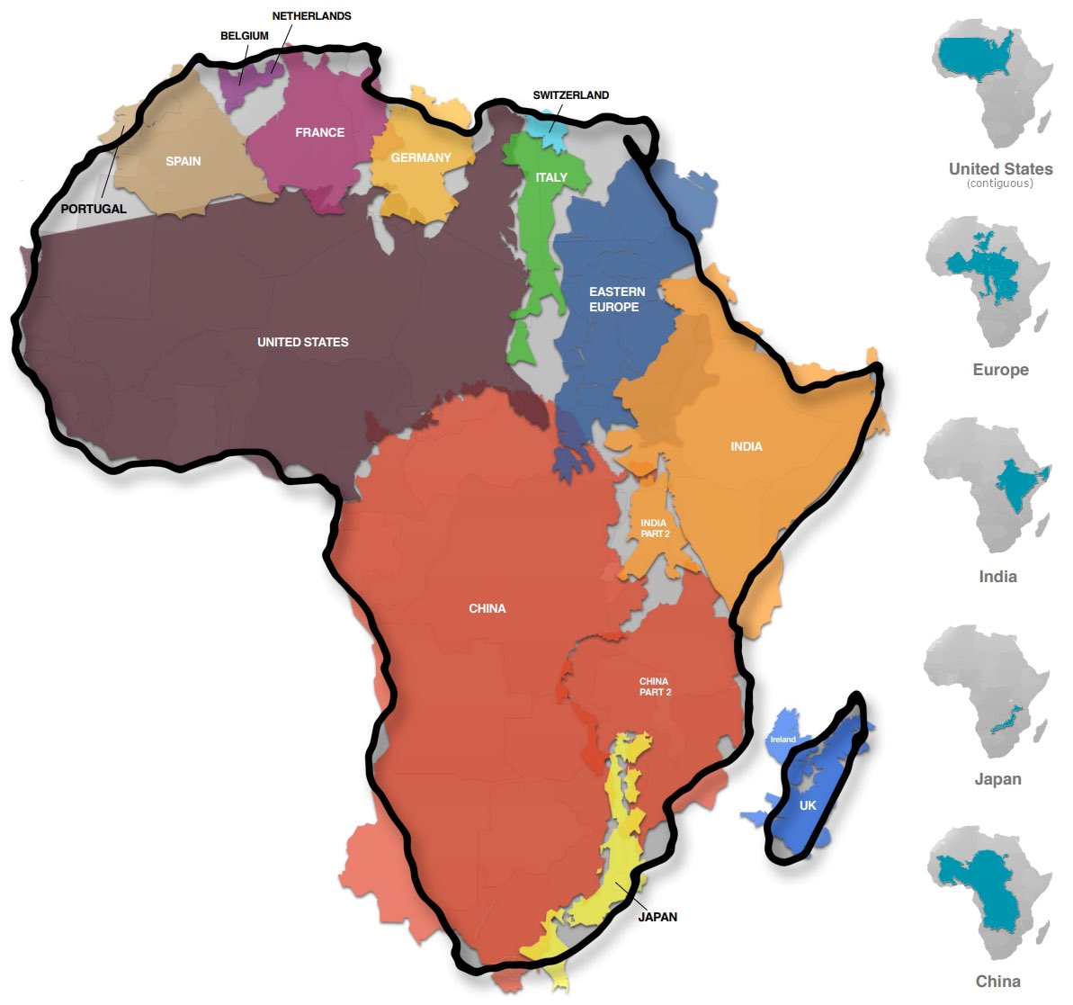
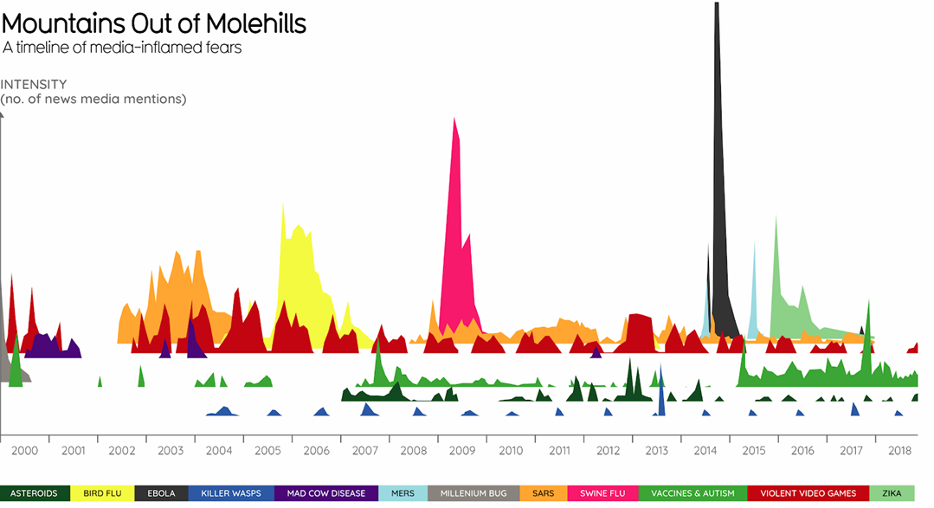
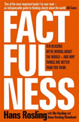
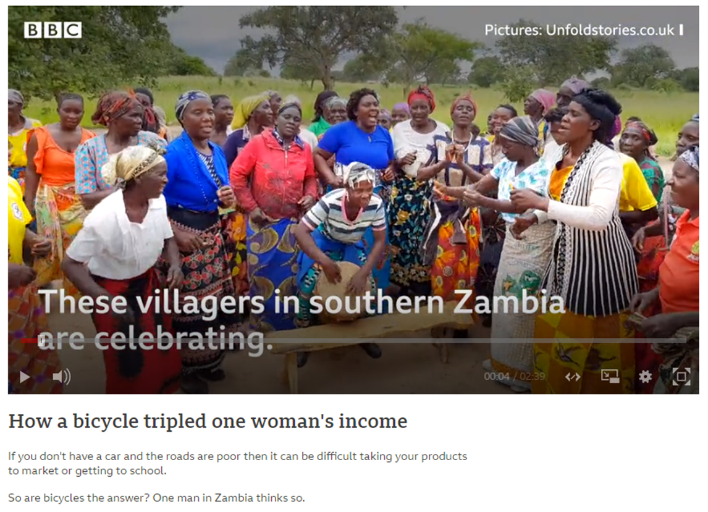
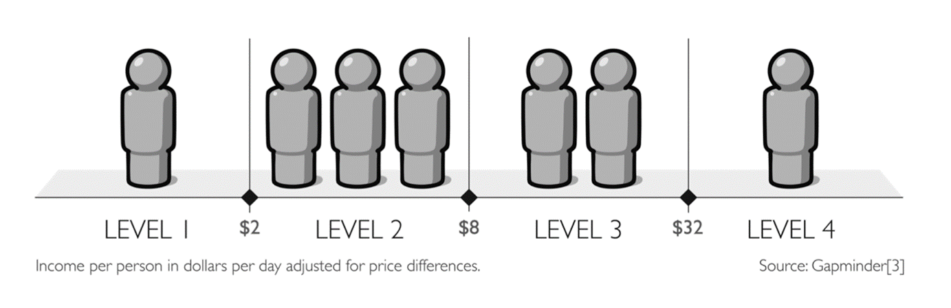

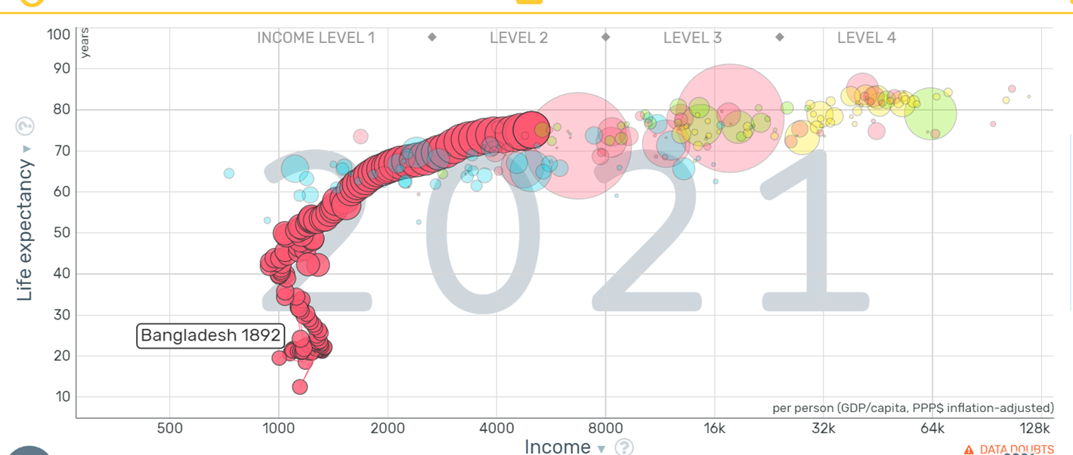
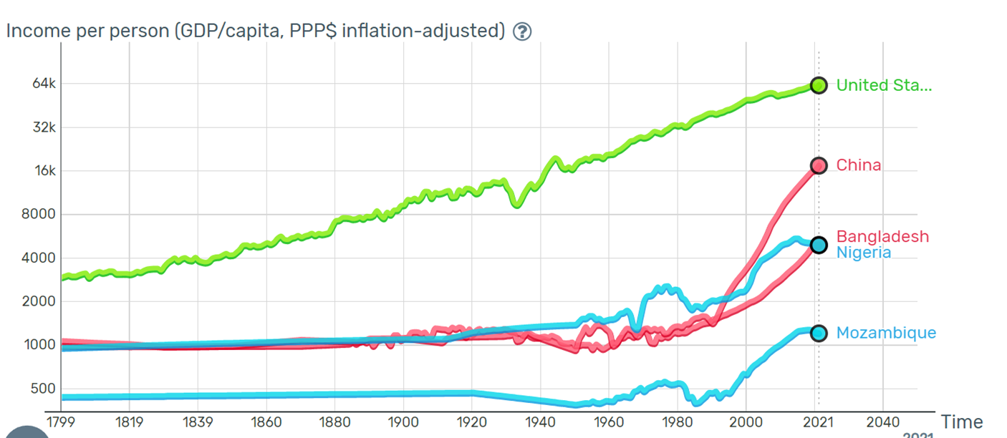
Factfulness. A view of development Year 9 HT4
Maps of the world can distort our view of the world and make some countries look bigger than they actually are and some look smaller than they actually are.
Does media hype alter our view of the world
Infant mortality: The number of babies who do not survive past the age of 1 per 1000 live births per year
Owning a bicycle can transform peoples lives. They are able to carry more to market and get there quicker so they have more time to work on their farms. This can triple their income and allow them to move out of level 1
Hans Rosling in his book on Factfulness divides the world into 4 income levels.
Level 1: 1 billion people live on less than $1 per day. They walk bare foot and may sleep on the floor
Level 2: 3 billion people live on $2-8 per day. You will have shoes and maybe a bike. Your family sleeps on mattresses
Level 3: 2 billion people live on $8-32 per day. You may have a motorbike and your children finish school
Level 4: You spend more than $32 per day. You have a car and may be able to go on holiday once a year. You will have a high school education
Small change is not no change. Around the world countries are improving life expectancy. Better access to health care and improved education is allowing many countries to move from level 1 to level 2 and onto level 3

Slide 9
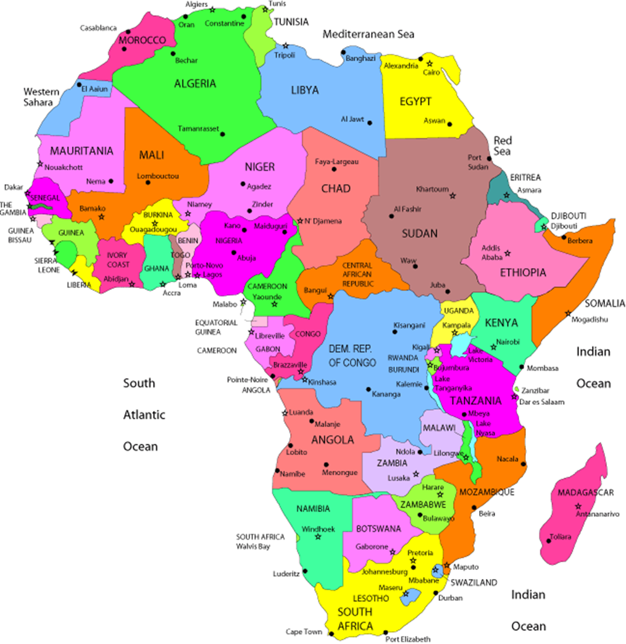
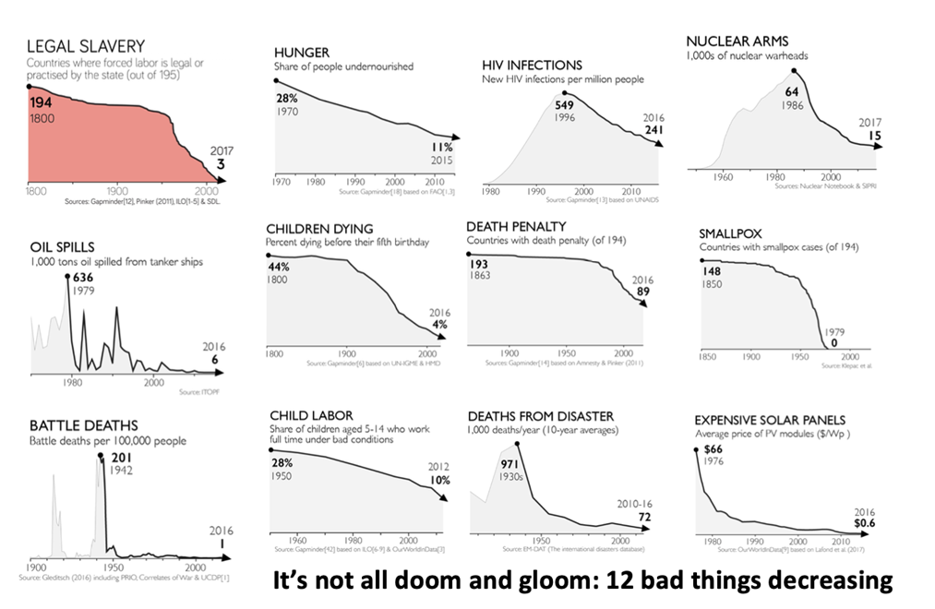
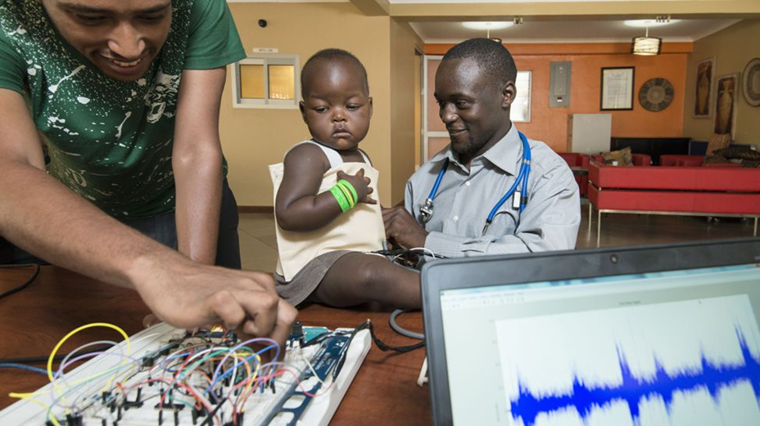
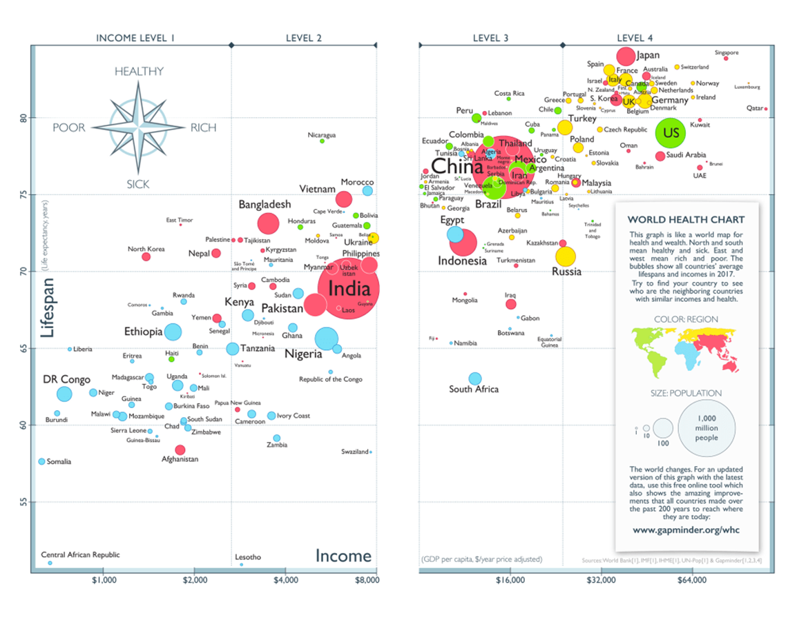
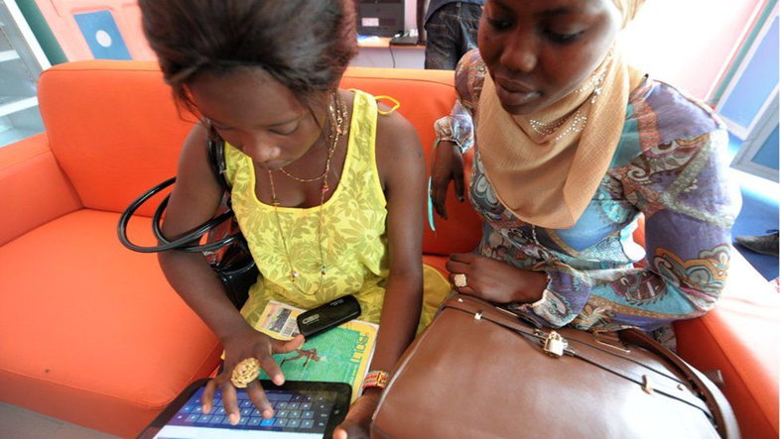
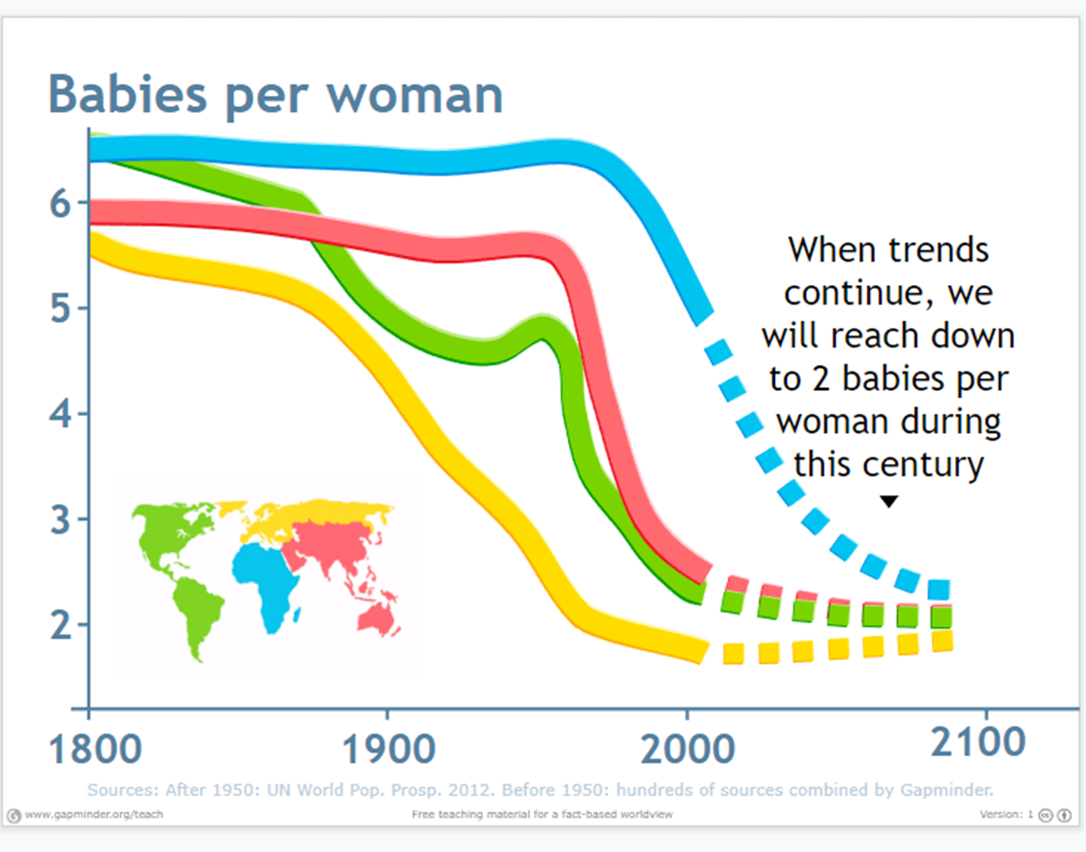
Factfulness. A view of development Year 9 HT4
Africa is NOT a country.
There is NO African language.
There is NO African flag
A stereotype is:
A widely held but fixed and oversimplified image or idea of a particular type of person or thing
The single story of Africa creates problems for the continent as it is seen as a place of poverty and it creates stereotypes that are not helpful in our understanding of the world
As of 2021, there were over 2,000 living languages in Africa. With 522 languages, Nigeria accounted for around a fourth of the total languages used in Africa.
A jacket that detects pneumonia
A currency that pays online workers
A quote from the book to help us.
“As billions of people left extreme poverty, most of them decided to have fewer children. They no longer needed large families for child labour on the small family farm. And they no longer needed extra children as insurance against child mortality. Women and men got educated and started to want better-educated and better-fed children: and having fewer of them was the obvious solution.”

Slide 10
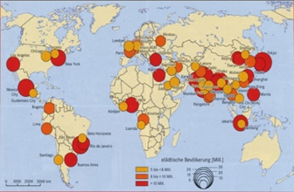
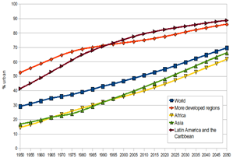
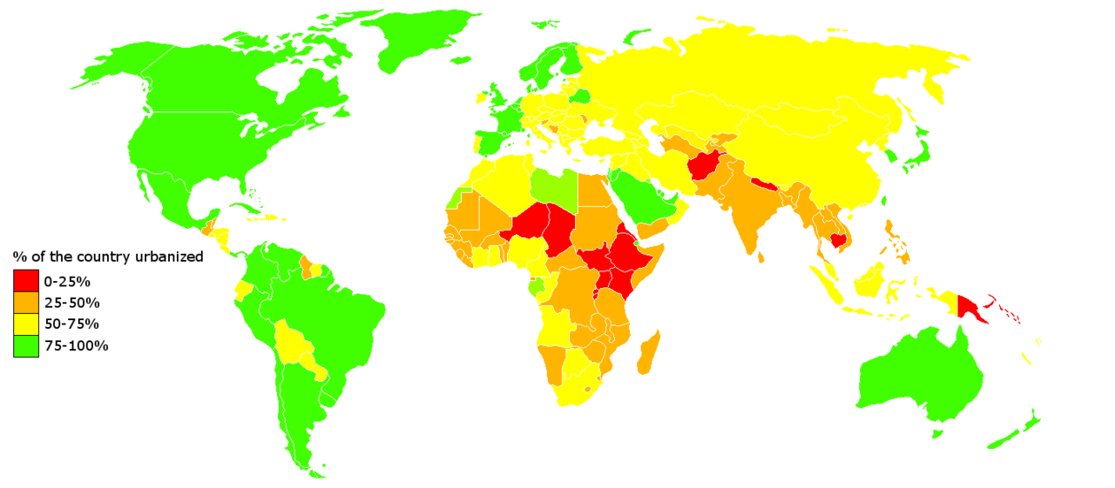
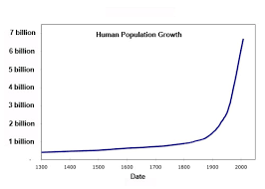
Urbanisation and Rio de Janeiro Year 9 HT5
What is Urbanisation?
This is the proportion of people living in urban areas such as towns or cities. In 2007, the UN announced that for the first time, more than 50 % of the world’s population live in urban areas.
Where is Urbanisation happening?
Urbanisation is happening all over the world but in LICs and NEEs rates are much faster than HICs. This is mostly because of the rapid economic growth they are experiencing.
Types of Cities
Megacity | An urban area which over 10 million people living there.
 |  | More than two thirds of current megacities are located in either NEEs (Brazil) and LICs (Nigeria). The amount of megacities are predicted to increase from 28 to 41 by 2030.
There are 3 types of Mega cities:
Slow Growing: No squatter settlements EG Tokyo ( Often in HIC’s)
Growing: Under 20% squatter settlements EG Rio De Janeiro (Often in NEE’s)
Rapid growing: Over 20% squatter settlements. EG Mumbai ( Often in Lics’s and Nee’s)
Causes of Urbanisation
Rural - urban migration (1) | The movement of people from rural to urban areas.
Push |  | Pull
Natural disasters War and Conflict Mechanisation Drought Lack of employment |  | More Jobs Better education & healthcare Increased quality of life. Following family members.
Natural Increase (2) | When the birth rate exceeds the death rate.
Increase in birth rate (BR) |  | Lower death rate (DR)
High percentage of population are child-bearing age which leads to high fertility rate. Lack of contraception or education about family planning. |  | Higher life expectancy due to better living conditions and diet. Improved medical facilities helps lower infant mortality rate.
The worlds population is increasing. Since 1900 this growth has been exponential (doubling)
Urban population is growing more quickly in less developed regions than in the more developed. The largest growth in urban areas will take place in China and Nigeria. These are examples of NEE’s ( Newly emerging economies)

Slide 11
Urban Change in a Major NEE City: RIO DE JANEIRO Case Study
Year 9 HT5
Location and Background
Rio is a coastal city situated in the South East region of Brazil within the continent of South America. It is the second most populated city in the country (6.5 million) after Sao Paulo.
City’s Opportunities
Social: Standards of living are gradually improving. The Rio Carnival is an important cultural event for traditional dancing and music.
Economic: Rio has one of the highest incomes per person in the country. The city has various types of employment including oil, retail and manufacturing.
Environmental: The hosting of the major sporting events encouraged more investment in sewage works and public transport systems.
Economic Challenges and solutions
Economic opportunities have lead to the growth of the formal economy ( Tax paid, holiday and sick pay) Rio provides more than 6% of Brazils employment and large companies are attracted to Rio. Jobs in the formal economy are mainly in public services with other areas in construction and finance.
There is a large informal economy in the favelas and few people pay tax.
Challenges are: Unemployment is high in many favelas its over 20%. The solution is the schools of tomorrow which offer training to school leavers. Crime is another challenge with powerful drug gangs in the favelas. The solution is the Pacifying police force who have reclaimed the favelas from the gangs
City’s Importance
It has the second largest GDP in Brazil It is headquarters to many of Brazil’s main companies, particularly with Oil and Gas.
Sugar Loaf mountain is one of the seven wonders of the world.
One of the most visited places in the Southern Hemisphere.
Hosted the 2014 World Cup and 2016 Summer Olympics.
Social Challenges and Solutions
Health: CH Life expectancy in the favelas is 45 and 80 in the rich areas. Infant mortality is higher in the favelas. SL Health visitors go into homes to check for 20 diseases
Education: CH Only 50% of children continue education beyond 14. Shortage of teachers. Parents need children to work. SL: Grants to poor families and new private University in Rochina.
Water Supply CH: 12% of Rio had no running water. 37% water lost through leaks. Frequent droughts. SL: 300km of new pipes, by 2014 only 5% with no water supply.
Energy CH: Frequent power cuts, poor people in the Favelas tap into electricity illegally. SL: 60km of new wires, new Nuclear power plant. $2billion spent on new HEP plant
Environmental challenges:
Air pollution and traffic congestion. There are around 5000 deaths from air pollution. Building new roads due to the steep hillsides is difficult and there is congestion . To solve this they have expanded the Metro system. Water pollution Guanabara Bay is heavily polluted. Many rivers are open sewers. The solution is 12 new sewage works. Waste Pollution many favelas are on steep slopes with no waste collection, The solution is a power plant the burns 30 tonnes of rubbish a day.
Migration to Rio De Janeiro
The city began when Portuguese settlers with slaves arrived in 1502. Rio is now home to various ethnic groups. More recently, millions of people have migrated from rural areas. People do this to search for a better quality of life.
This expanding population has resulted in the rapid urbanisation of Rio de Janeiro.
Managing the Favelas and the urban poor
As the favelas have grown there are many challenges Crime, health, services, construction and unemployment. The Favela Barrio Project is a Site and service scheme. It is an area in the north zone. Roads were paved, improved sanitation, a cable car and the pacifying police all helped to improve quality of life.
A success is that quality of life and employment has improved. A problem is that residents don’t have the skills to keep on top of repairs to the cable car and their homes

Slide 12
Sustainable Urban Living: Freiburg Year 9 HT6
Planning for urban sustainability
Problems encountered in cities:
Overcrowding
Buildings competing for space
Huge electricity consumption
Demands on water and other resources
Waste disposal
Traffic congestion
Examples of sustainable urban strategies:
Providing green spaces
Recycling water to conserve supply
Reducing reliance on fossil fuels by rethinking transport options
Conserving cultural, historical and environmental sites and buildings
Minimising the use of greenfield sites by using brownfield sites instead
Involving local communities and providing a range of employment
Keeping waste within the capacity of rivers and oceans.
Key terms:
Sustainable – meeting the needs of the present without reducing the ability of future generations to meet their needs.
Brownfield site – land that has been used, abandoned and now awaits reuse.
Greenfield site – A plot of land, often in a rural area that has not been built on before.
Frieburg – An example of a city planning for urban sustainability
The German city of Freiburg set itself the goal of sustainability in 1970
Freiburg is a city in the south-west of Germany, close to the border of France and Switzerland
Freiburg’s sustainable approach considers the environment, but also the social and economic effects of sustainability on its citizens.
Social planning in Freiburg (taking into account people’s needs):
Local people are involved in urban planning at the local and city level.
Local people can invest in renewable energy resources.
In addition to financial returns investors in renewable energy receive free football season tickets.
Financial rewards are given to people who compost their green waste and use reusable nappies.
Economic planning in Freiburg (involves providing people with employment):
Jobs for local people provided by –
  Conferences on sustainability
  Research and manufacture of solar technology
AO1 Example:
Freiburg’s solar valley employs more than 1000 people. The solar training centre employs 250 people. Many solar institutions have their HQs in Freiburg. The city hosts solar conferences.
Environmental planning in Freiburg
Ensures that resources are not wasted and the environment is protected. A key strategy is reducing the amount of waste produced.
In Freiburg:
More than 1 million corks are recycled per year.
More than 88% of packaging waste is recycled.
Annual waste disposal has been reduced from 200,000 tonnes to 50,000 tonnes in jut 12 years.

Slide 13
Sustainable Urban Living: Freiburg Year 9 HT6
Making urban water supply, energy, waste and green spaces sustainable
Water supply:
Sustainable water supply depends on individuals using as little water as possible. This involves collecting and recycling water rather than taking water from reservoirs.
Homes need to have roof gardens with facilities for rainwater harvesting and wastewater recycling.
Groundwater has to be protected from pollution as it is an important source of drinking water.
What are they doing in Freiburg?
Freiburg’s waste water system allows rainwater to be retained, reused or to seep back into the ground.
There are financial incentives for inhabitants to use water sparingly.
In Vauban District water conservation includes; collecting rainwater for use indoors, green roofs, pervious pavements that allow rainwater to soak through, unpaved tramways and drainage wetlands.
Water in the River Dreisam is managed using flood retention basins. These store excess water to prevent flooding. The water is then used in the cities.
Energy conservation:
Cities make great demands on energy supply. Burning fossil fuels has provided most of this energy before now. Pollution and climate change mean that finding a sustainable energy supply is increasingly important.
What are they doing in Freiburg?
Freiburg has a strict energy policy based on:
Energy saving
Efficient technology
Use of renewable energy sources
The city plans to be 100% powered by renewable energy sources by 2050. It is one of the sunniest cities in Germany, so solar power is an important form of renewable energy. There are about 400 solar panel installations in the city, including the main train station and the football stadium.
Creating green spaces:
Provision of green spaces contributes to sustainability in economic and environmental terms.
They serve as the city’s green lungs and help to keep the air clean.
Soil is protected and prevents run off of water in heavy rainfall.
Green spaces provide free recreation and habitats for wildlife.
What are they doing in Freiburg?
44,000 trees have been planted in parks and streets.
40% of the city is forested.
In the Risenfeld District only 78 hectares are built on, leaving 240 hectares of open space.
44% of wood from the cities forests is used for timber but 75% grows back within a year.
Waste recycling in Freiburg:
Each household is provided with three bins, one for paper, one for organic waste and garden waste and one for non-recyclable material. They also have a yellow sack for packaging. The biobin is collected once a week, the others every two weeks
There are three permanent recycling yards in the city. Freiburg recycles 70% of its total waste. Recycled paper is used in school exercise books and disposable drinks containers are banned.

Slide 14
Sustainable Urban Living: Freiburg Year 9 HT6
How can urban transport strategies reduce traffic congestion?
Why is there a need to reduce traffic congestion?
Traffic congestion can lead to air pollution. There are also negative economic effects of increased journey times, higher fuel consumption and greater risk of accidents.
Freiburg:
The city has an integrated traffic system which is updated every ten years. It is based around the tram system which provides efficient, cheap and accessible public transport.
What has Freiburg done?
Created the ITS.
Built 400km of cycle paths with 9000 parking spaces for bikes including ‘bike and ride’ facilities at railway and bus stations.
Placed restrictions on car parking spaces; in Vauban district a parking space costs £20,000.
Lowered fares on the trams allowing unlimited travel around the city.
Given free tram tickets with concert, sports and other events in the city.
What has the impact been?
Freiburg has a low car density with less than 500 cars per 1000 residents. Tram journeys have increased by 25,000 per year.
Singapore:
Singapore is a small island with limited space, making traffic congestion a real problem.
What has Singapore done?
Restricted entry to the city centre during rush hour.
Introduced a quote system to reduce the number of car owners.
Increased petrol prices.
Financial incentives for using cars only at the weekend.
Advanced electronic monitoring and control of traffic signals to keep traffic flowing.
Development of an overhead railway system and efficient bus network.
What has the impact been?
45% less traffic and 25% fewer accidents in the city centre.
Traffic in the city centre has reduced by 40%.
Car ownership has declined by 1%.
Beijing:
Beijing has an estimated 5 million cars. The city centre is often gridlocked. Congestion is predicted to get worse.
What has Beijing done?
Limited car sales – only 20% of people who apply to own a car are successful.
Restricted vehicle use – cars are banned from the city for one day a week based on a number plate system.
Increased parking fees – Congestion charge and pollution tax have been introduced.
Expansion of the public transport system – 30 new metro lines and a rapid bus transit system are to be built by 2020.
What has the impact been?
There has been a 20% drop in car use.
There has been a 12% drop in the use of car parks in the city centre.
BUT building and widening of roads has resulted in increased car use at the expense of cycling.

