Slide 1
Geography Knowledge organisers
Year 8

Slide 2
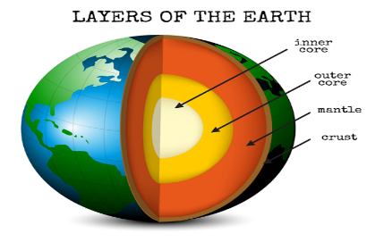
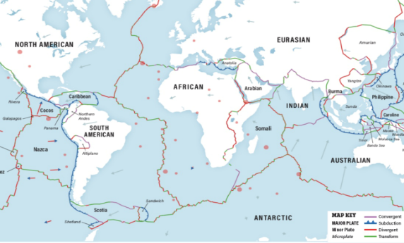
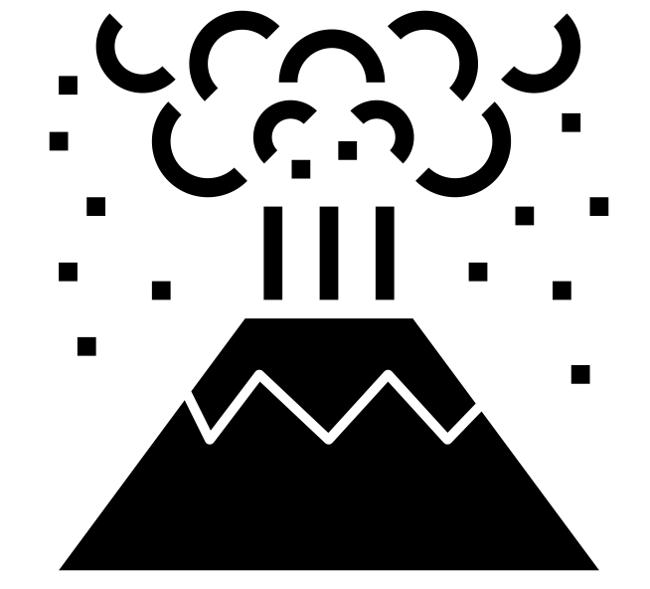
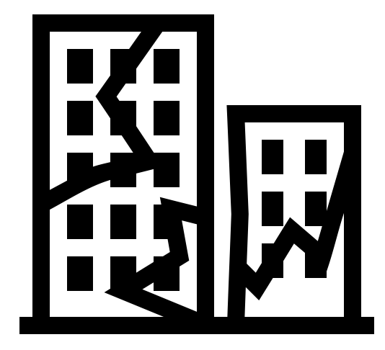
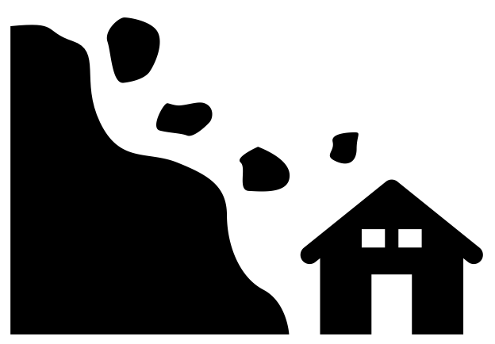
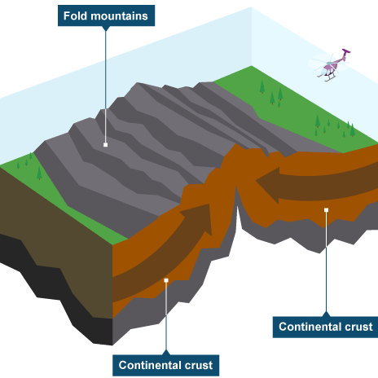
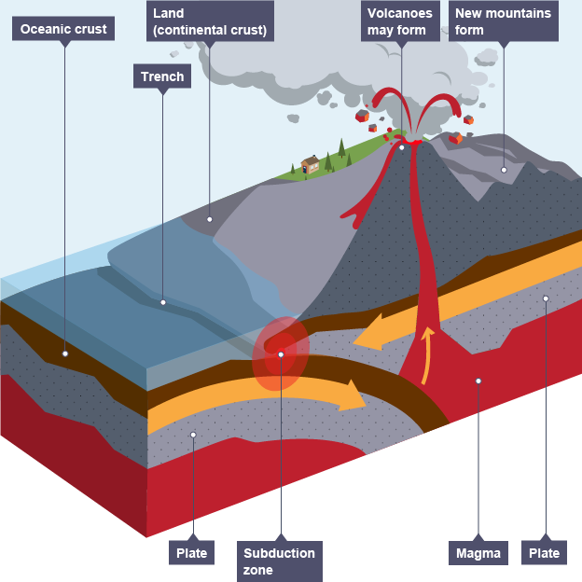
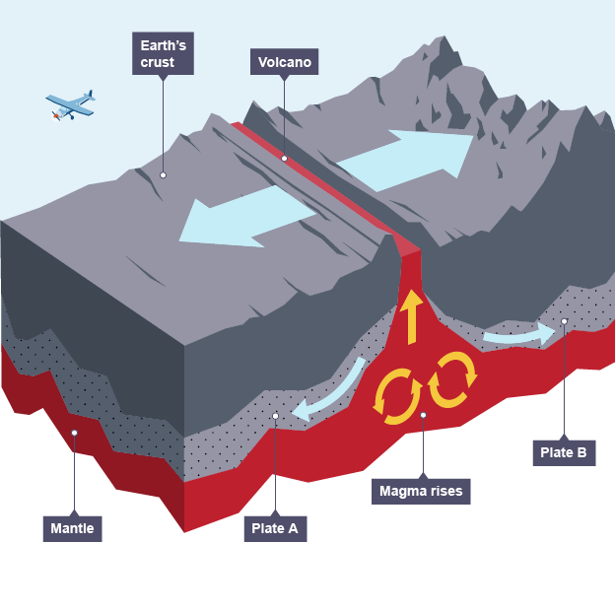
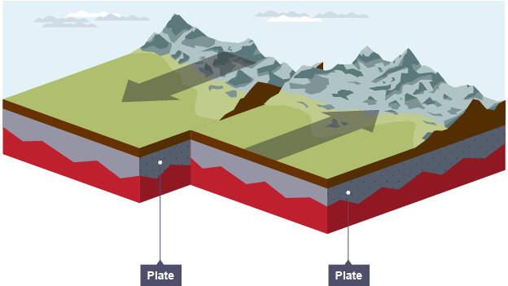
Restless Earth Year 8 HT1
Structure of the Earth
The inner core is extremely hot (5,500ºC) it is a very dense solid made from iron and nickel
The outer core is 2,000 km think and is a liquid
The mantle is semi-molten and about 3,000km thick, The closer the mantle is to the core, the more liquid it is.
The crust is the rocky outer later which we live. It is thin compared to other sections and made up of oceanic and continental plates
Plate Margins
The Earth’s crust is broken into different plates, which sit on the Earth’s mantle. These plates move because of convection currents. The plates move in different directions and meet at plate margins. As the plates move, parts of the curst are destroyed and in other areas new crust is created.
Oceanic plates carry the oceans. They are thinner but denser than continental plates.
Continental plates carry the land. They are thicker but less dense than oceanic plates.
Destructive
Constructive
Conservative
Key Terms
Mantle, Core, Pacific Ring of Fire, Earthquake, Volcano, Tsunami
Effects, Seismic, Tectonics , Constructive margin, Destructive margin
Conservative margin, Collision margin, deform, pressure, friction
Destructive
Movement: The plates collide and the oceanic plate is subducted (sinks) under the continental plate.
Example: West coast of South America. The Nazca plate is being forced under the South America plate.
Landforms and Hazards: Volcanoes, fold mountains and oceanic trenches are formed. Earthquakes
Collision (Destructive)
Movement: The two continental plates collide
Example: The Indo-Australian plate and Eurasian plate creating the Himalayas
Landforms and Hazards: Earthquakes
Constructive
Movement: The plates move apart
Example: Iceland -The North American and Eurasian plate are pulling apart creating the Mid Atlantic Ridge
Landforms and Hazards: Volcanoes and Earthquakes
Conservative
Movement: The plates move alongside each other
Example: West of North America. The North American and Pacific plate
Landforms and Hazards: Earthquakes

Slide 3
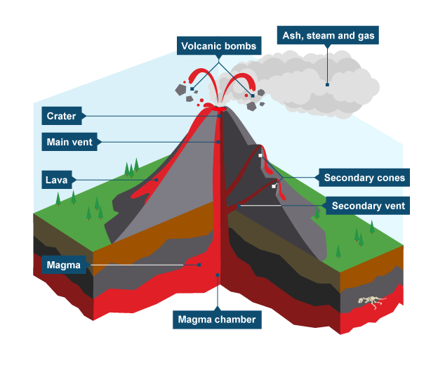
Restless Earth Year 8 HT1
Effects of Volcanic Eruptions
Positive Effects | Negative Effects
The dramatic scenery created by volcanic eruptions attracts tourists. This brings income to an area. | Lives can be lost – 21 people were killed by the White Island (New Zealand) eruption in December 2019.
The lava and ash deposited during an eruption breaks down to provide valuable nutrients for the soil. This creates very fertile soil which is good for agriculture | If the ash and mud from a volcanic eruption mix with rain water or melting snow, fast moving mudflows are created. These flows are called lahars.
The high level of heat and activity close to a volcano can provide opportunities for generating geothermal energy | Lava flows and lahars can destroy settlements and areas of woodland or agriculture
Measuring Earthquakes
In the past, the Richter scale was used to measure the power of earthquakes. Earthquakes are now measured using the Moment Magnitude Scale (or simply Magnitude scale). This measures the size of the seismic waves during the earthquake. Each step in the scale is ten times greater than the previous number. This is a logarithmic scale from 0-10. The amount of damage caused by an earthquake is measured by the Mercalli Scale. This is a measure of intensity, and changes according to which area you are measuring - damage nearer the epicentre would usually be greater than further away.
Large earthquakes are usually connected with plate margins. Earthquakes happen often but most are too small for us to notice. Seismometers record earth movements.
An earthquake is a sudden shockwave caused by rocks being under stress from the movements of plates at plate margins. Eventually the stress in the rock builds up enough to deform and reach breaking point. At that point, the stored up energy is released in the form of shockwaves.
Effects of an Earthquake
 | Social Impacts | Economic Impacts | Environmental impacts
Short Term: | People may be killed or injured. Homes may be destroyed. Infrastructure may be disrupted. Water supplies may be contaminated. | Shops and business may be destroyed. Looting may take place. | The landscape may be destroyed because of fires or landslides Tsunamis may cause flooding in coastal areas
Long Term: | Disease may spread. People may have to be re-housed, sometimes in refugee camps | Rebuilding can be expensive. Income could be lost | Important natural and human landmarks may be lost.
Structure of a Volcano
How to reduce risk from earthquakes:
Prediction
Prediction involves using seismometers to monitor earth tremors. Experts know where earthquakes are likely to happen. However, it is very difficult to predict when they will happen. Even looking at the timescale between earthquakes doesn't seem to work.
Protection
Protection involves constructing buildings so that they are safe to live in and will not collapse.
Preparation
In earthquake-prone countries, hospitals, emergency services and residents practise for an earthquake. They have drills in all public buildings so that people know what to do in the event of an earthquake. This helps to reduce the impact and increases their chance of survival.

Slide 4
Living off the Earth’s resources Year 8 HT2
What are natural resources?
A natural resource is something which occurs naturally – without any help from us – and which we can make use of. Like water, soil, wind, sunlight, coal and oil.
Some resources are renewable, which means we can keep on using it and it won’t run out (for example sunlight).
Some resources are non-renewable, which means that it forms slowly, and we are using it faster than it is forming (like oil).
Resources are not shared equally across the world.
How can we tackle water scarcity?
By 2025 half the world’s population will face water scarcity. There are solutions to this:
Using water more wisely – by watering crops only when needed, or by using less water in the bath at home.
Bring in water from other places – For example China’s water transfer schemes.
By using salt water – using desalinisation techniques, you can remove salt from water to make it save for humans to drink.
What is happening to the Earth’s soil?
Soil provides nutrients that plants need, it also provide them with water and oxygen.
Soil is not shared equally across the Earth’s surface. It depends upon the type of rock in a place, the climate and relief.
Earth only has a limited amount of land that is suitable for crops.
Is there enough water?
97% of the water on our planet is salty water.
3% of the water on our planet is fresh water, of which less that 1% is fresh water that we can use.
Fresh water is not equally shared across the planet. It is scarce in some places, and plentiful in others.
Some areas have physical water scarcity, where there just isn’t enough water to meet everyone’s needs. This might be because of over population or low rainfall.
Some areas have economic water scarcity, where people cannot access water because of poverty. These areas can’t afford the infrastructure to bring fresh water to everyone.
Key Vocabulary: Desertification, Groundwater, Aquifer
Economic water scarcity, Soil erosion, Non-renewable resources
Renewable resources, Fossil fuels, Drought, Extinction, Irrigate,
Ambitious vocabulary: Desalinisation, micro dosing, mitigation, infrastructure

Slide 5
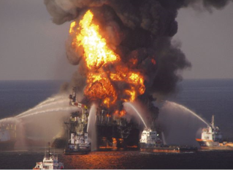
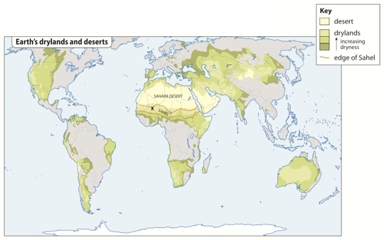
Living off the Earth’s resources Year 8 HT2
How do we damage our soil?
Our population is growing, but the amount of fertile soil is shrinking. Why is this?
We bury soil under concrete.
We contaminate it with dust and fumes from factories.
We cut down the trees that protect it.
We let too many animals graze on it.
We grow overgraze and use too much fertiliser on it.
Soil erosion is a product of these actions. This is when the fertile top soil is carried away by wind or water. It can lead to desertification.
What is happening with the world’s oil?
Oil forms from tiny sea creatures which die, get buried in sediment and, after being exposed to heat and pressure, turn into oil. Humans then extract the oil from the sea bed, or from underground.
Oil is used for transport, heating, electricity and to create medicines and plastic.
Oil is harmful to the environment.
When you burn it, it produces
greenhouse gases which cause
global warming. It also produces
Sulphur dioxide which causes acid rain.
Oil spills harm the environment.
What are the solution to desertification?
In the Sahel, farmers have developed methods for fighting desertification.
Planting trees and bushes
Storing rainwater when it falls
Scientists are also
working to develop
new crop breeds
that will grow
more effectively on
poor soil, or in
drought.
Is renewable energy the future?
There are a number of types of renewable energy.
Biomass
Hydro-electric Power
Wind farms
Solar power uses solar cells to change sunlight into electrical energy. It is particularly valuable in poor countries, where access to other forms of power might be difficult.
Digging Zai Pits
Microdosing
Wave power
Tidal power
Solar farms
How do we affect other species?
There are 1.7 million other known species on our planet. Scientists think at least 10 species become extinct each week. Some scientists believe humans are causing a mass extinction through deforestation, pollution, hunting, fishing and burning fossil fuels.

Slide 6
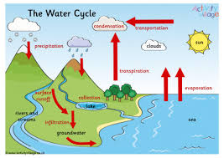
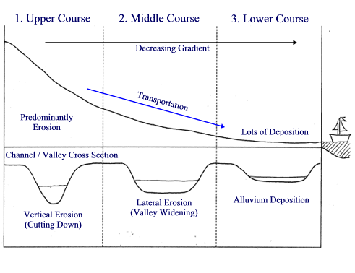
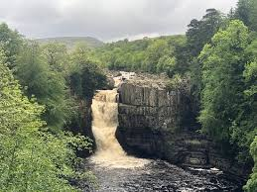
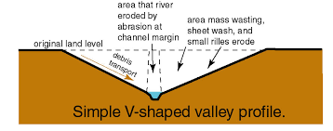
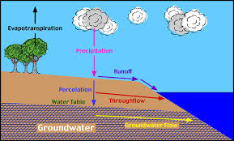
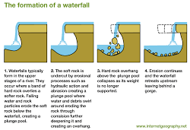
RIVERS Year 8 HT3
Key Words:
Erosion
Hydraulic action
Transportation
Deposition
Waterfall
Meander
Source
Mouth
Drainage basin
Precipitation
Upper course
Middle course
Lower course
Abrasion
Plucking
As a river flows towards the sea it will change shape. The Long profile is how it changes from the source to the mouth and the cross profile is how the river channel changes from source to mouth.
All the water that has ever been on our planet is still here. It moves through the land the water and the atmosphere and it can be a solid in ice, a liquid in rivers and sea and a gas as it is evaporated.
The UPPER course of the river is where the source of the river is found. This is usually in the mountains and hills where there is high rainfall. Features here are V shaped valleys, interlocking spurs and waterfalls.
Once the rain falls and the water hits the ground it can move through the land in a number of ways. Surface flow, through flow and groundwater flow.
High Force is a waterfall on the River Tees
Eventually all the rainwater that falls onto the ground will end up back in the sea.
The fastest route for the water to get into rivers is surface flow. Building on the ground increases surface flow and can increase the risk of rivers flooding.

Slide 7
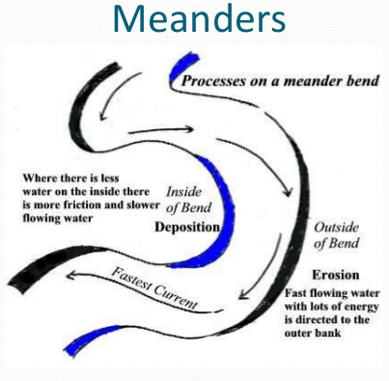
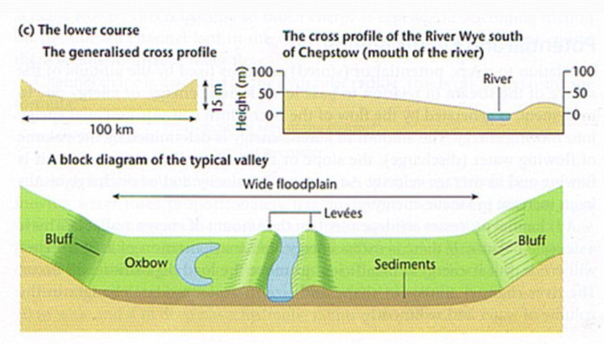
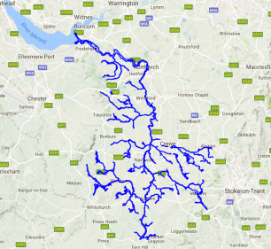
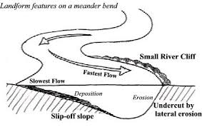
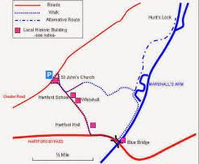
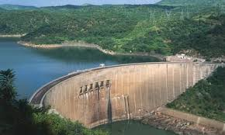
RIVERS Year 8 HT3
The Middle course of a river is characterised by both erosion and deposition
The Lower course of the river is characterised by deposition. As the river reaches the sea the flow is slowed.
The River Weaver is our local river. Where it meets the river Dane in town is known as a CONFLUENCE
A wide flood plain and natural levees are features of deposition found in the lower course of the river.
In many places the river Weaver has been artificially straightened this was done to allow the salt boats to reach the salt mines and the Mersey for export
Along the journey of the river humans can have an effect. Rivers can be dammed to create hydro electricity, pollution from factories can get into the water. In some places rivers are straightened to speed the flow to help to reduce flooding. Rivers are used to transport goods and for leisure activities too.
One place this has happened is at Marshals Arm.
A meander is a key feature of the middle course of the river. As a meander becomes more extreme in its shape the neck becomes narrow. Over time the river breaks through the neck to form an Ox-Bow lake.

Slide 8
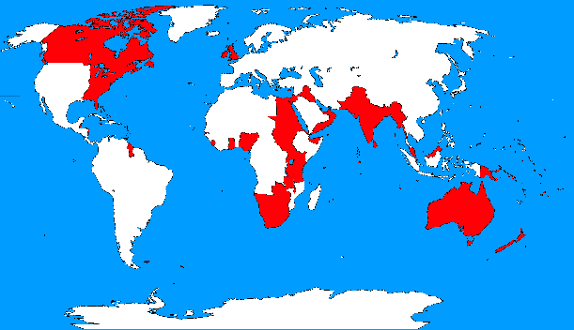
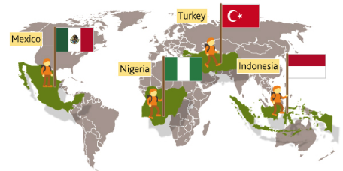
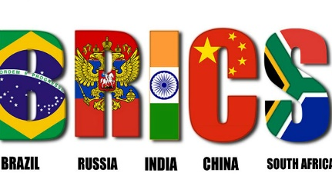
Super Powers Year 8 HT4
Definition of a superpower: A superpower is an extremely powerful country, especially one capable of influencing international events and the acts and policies of less powerful countries. It’s power can be felt all over the world.
What made the UK a superpower?
Industrial development and technology. (steam power)
A large and successful Navy
Factors that make a country a Superpower:
Military
Government ( political stability)
Money
Resources
Population
Soft power
The British Empire was known as
‘The Empire on which the sun never set’
The British Empire collapsed for a number of reasons.
Bankruptcy
The rise of new super powers
WW1
Indian Independence
Opinion at home
nationalism
A Legacy of the British Empire is something that was left behind. Eg speaking English, driving on the left, slavery, loss of native culture
Uni-Polar: A world with one country with the most power
Bi-Polar: A world with two countries being the most powerful
Uni-Polar : A world with more than three powerful countries
BRIC countries are: Brazil, Russia, India, China
MINT countries are: Mexico, Indonesia, Nigeria, Turkey
China has become a global superpower as it:
Has influence over many neighbours
It is a large country with many resources
Many rivers and a long coastline are good for trade
A large pool of workers
Benefits in China:
Lot’s of people now work in factories, which provides them with an income.
China has grown an economy responsible for bringing more people out of poverty than any other country in the world.
Although the wages of the workers in China are low, there is also a low-cost of living which makes life manageable
HIC: High Income |Country
LIC: Low Income Country
NEE: Newly emerging Economy

Slide 9
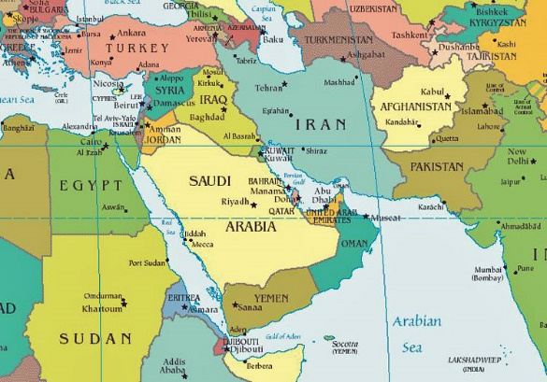
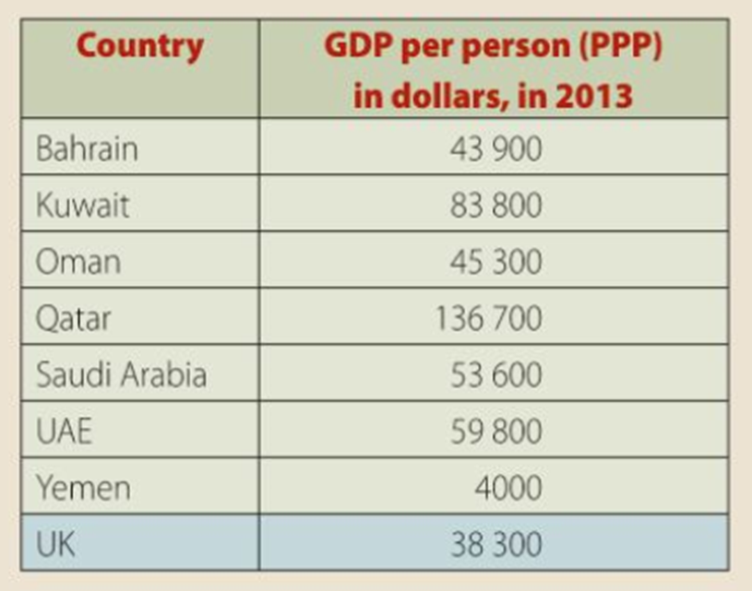
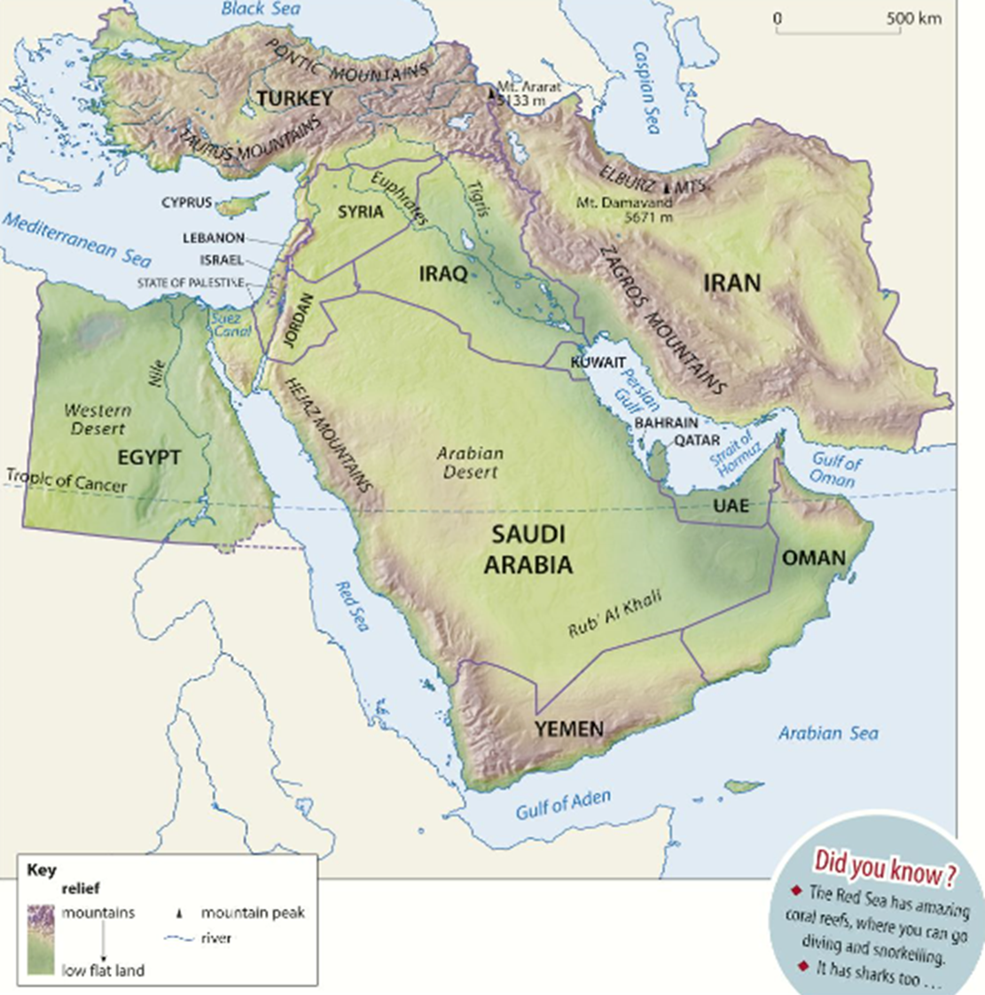
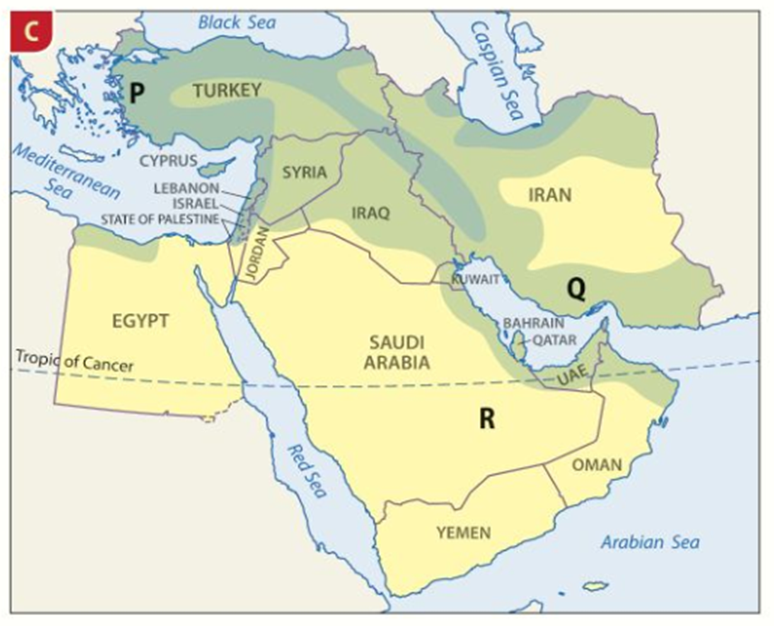
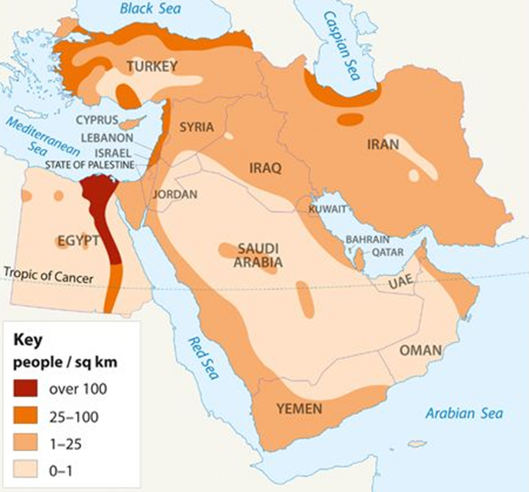
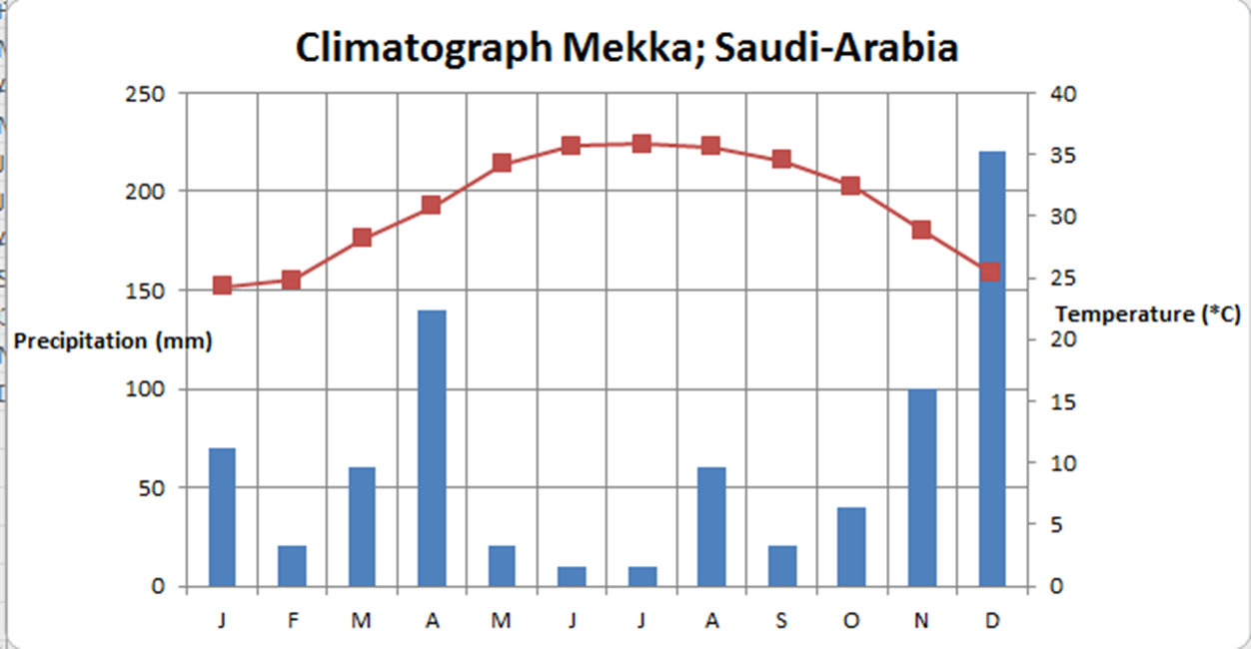
THE MIDDLE EAST Year 8 HT5
KEY WORDS:
Biome
Desert
Physical Geography
Grassland
Forests
Conflict
Tourism
Region
Arabian Peninsula
Population density
GDP
For many treasons some countries in the Middle East are richer than others. Those countries that have got oil have been able to become very wealthy. Other countries with poor natural resources are poorer. However the wealth in the rich countries is not always shared equally.
The Middle East is a region made up of a number of different countries. These countries all have different landscapes, languages, religions and customs
The climate and the landscape also has a big impact on where people live in the Middle East. Places where people can farm, get reliable water or other resources are the most densely populated. A choropleth map uses one colour to show the proportion of people living in one place.
Once upon a time, the Middle East was part of the Ottoman Empire. This Islamic empire existed from around 1299 to about 1918 and from 1454 claimed Constantinople (Istanbul today) as its capital city. By 1914 the empire was declining, and had lost areas like Egypt in wars. In WW1 the empire fought against Britain, France and Russia. When they lost the war, the empire was divided up between Britain and France, which caused a lot of tension. The whole of the Middle East is now independent.
The climate of the Middle East is also varied and this is due to the landscape. Deserts are hot and dry, the mountains can be snow covered in winter.
The Middle East has a varied landscape made up of Mountains, deserts, marshlands and coastlines. The Arabian peninsular is largely made up of Desert, one part of this is called the Rub Al Khali or the Empty Quarter

Slide 10
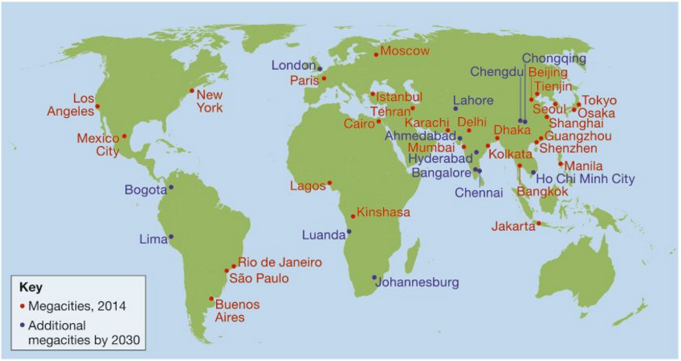
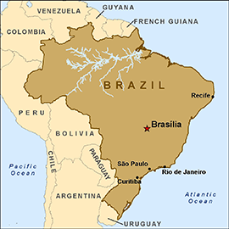
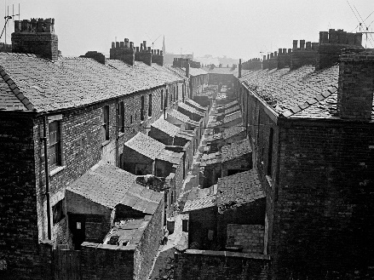
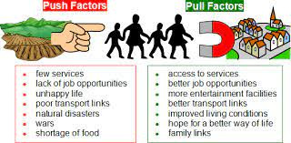
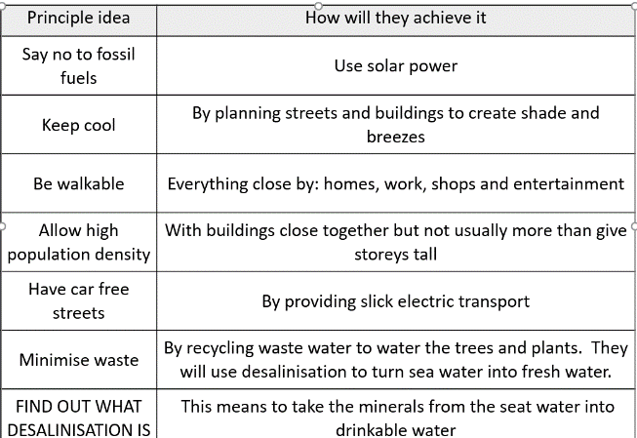
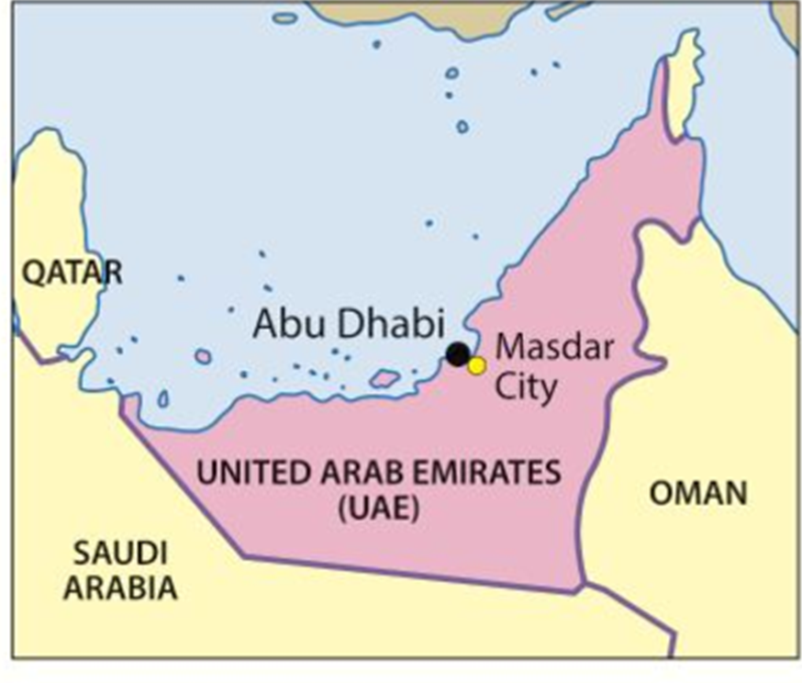
URBANISATION Year 8 HT6
Year 8 Urbanisation
Urbanisation is the proportion of people living in an urban area
Key terms:
Slums
Migration
Push and Pull
Rural
Urban
Sustainable
Redevelopment
Regeneration
Shanty town
Favelas
Mega Cities have a population of more than 10 million people
Migration
Push and pull factors: Push factors make you want to leave a place. Pull factors make you want to move to a place
Rio De Janeiro in Brazil
The growth of the favelas in Brazil was the result of population growth in the city due to migration. People arrived in the city with nowhere to live so they built on land that no one wanted with materials that they found lying around
Problems of the favelas. Overcrowding, no planned sewage, poor electricity and water supplies, low life expectancy, crime
Growth of Manchester
Manchester grew from a small settlement during the Roman times (AD79) into a large city driven by Industry and the growth of the cotton mills. This lead to a growth in housing and an increase in slum buildings
Solutions for the favelas were to help people to build their own homes. They built cheap apartments and provided water and electricity
MASDAR is a purpose built sustainable city in the UAE
By the 1990’2 much of Manchester was REDEVELOPED (old buildings knocked down) and new buildings built. Some areas were REGENERATED (old buildings kept but turned to a new use like apartments)

